Slide 1
Expanding into VHF
… and beyond!
10 Sept 2022
Randy Wing, N0LD
636-459-0964
N0LD@arrl.net

Slide 2
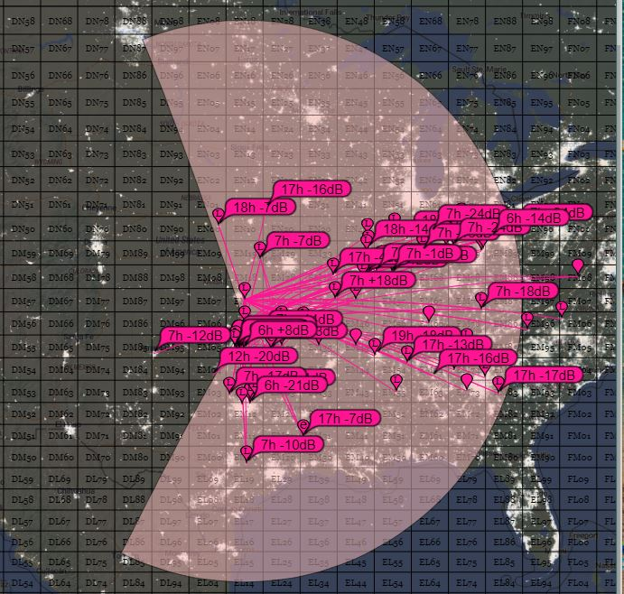
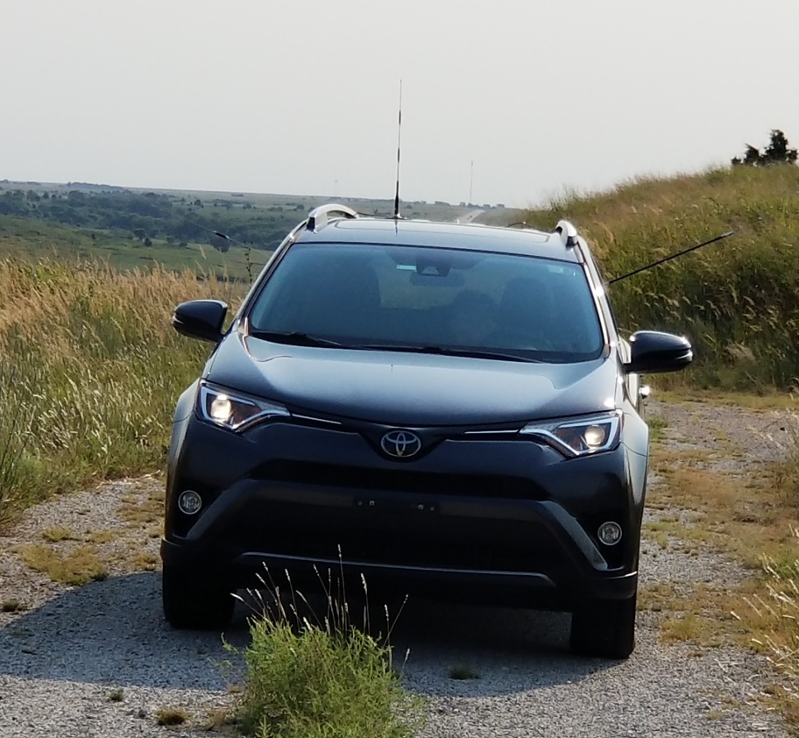
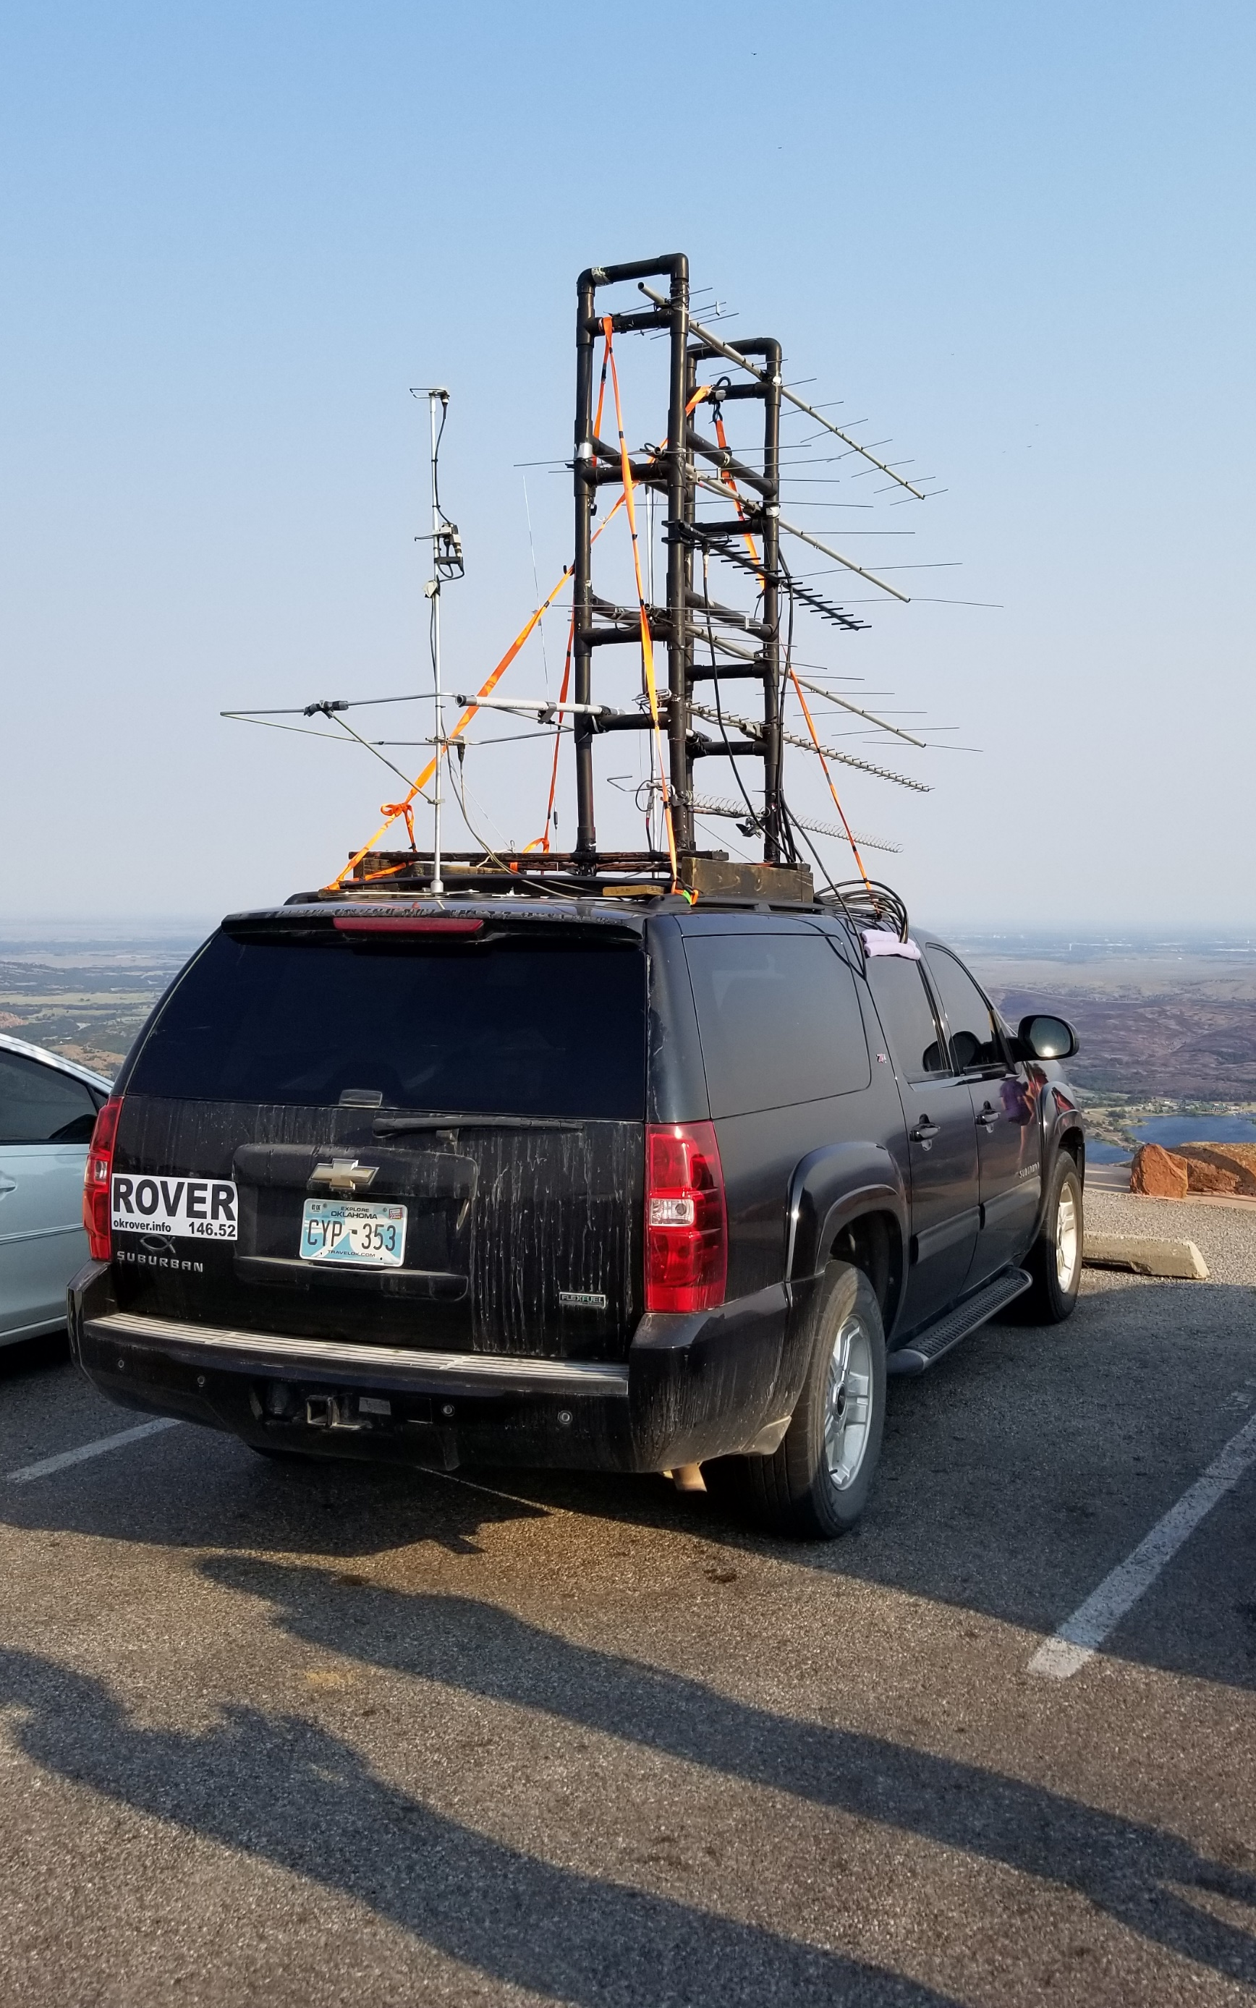
Stations that
Heard us on 2m
September 2021 VHF Contest
Mt. Scott – EM04
70 miles SE of Wichita, KS – EM17
N0LD/R – Randy, Harvey KB0YHT/R - Nick

Slide 3
Do I need mucho $$$? No!
KB0YHT/R’s setup included:
  Used Yaesu FT-100 (160m through 70cm all-mode radio)
  2m/70cm mag-mount vertical – on the side of his car- horizontal
  6m vertical – on the side of his car - horizontal
Band openings happen all the time – but how often? - I’ll get to that!
VHF Contests happen occasionally – but how often? - I’ll get to that!
Key Factors
Modest Expenses – Extraordinary Results!

Slide 4
What Do you mean “expand” into VHF … and beyond?
VHF Definition
Why VHF?
Where can I take this?
Advanced Topics
Operate “beyond” what you do today! Stretch yourself!

Slide 5
VHF Definition
VHF extends from 30 mhz to 300 mhz which includes:
    6 m 50-54 Mhz
    2 m 144-148 Mhz
    1.25 m 222-225 Mhz
UHF extends from 300 mhz to 3 ghz which includes:
    70 cm 420-450 Mhz
    33 cm 902-928 MHZ
    23 cm 1240-1300 Mhz
    13 cm 2300-2310 MHZ and 2390-2450 MHZ
“Microwave” is what hams call the bands above UHF (sometimes above 1 Ghz
    5 cm 5650-5925 MHZ
    3 cm 10 – 10.5 Ghz
    Many more … including light!
This isn’t a test!

Slide 6
WHy VHF?
VHF is an entry into Amateur Radio – almost everyone has a 2m handheld!
VHF has so many avenues to explore!
  FM Repeaters -> FM Simplex -> Other modes!
  VHF Contesting (FM only, Participation, Competing, Setting Records)
  APRS – good way to tell when there are VHF openings
  Meteor Skip
  Amateur Satellite communication (FM -> USB/LSB -> Digital)
    International Space Station Communication
  Moon Bounce
Extend your range – extend your fun!
Are you Curious? This is what VHF is about!

Slide 7
VHF and Height - FM
The higher the antenna the better for VHF
At a glance this seems obvious, but how high do I need my antenna?
Buildings and hills block VHF Signals (mostly)
Vegetation is a minor impedance on VHF; major impedance on UHF+
As you start, get your antennas above your house, then the trees, then higher
If you are mobile, seek out the peak of hills
If you are buying land, buy a house on a hill, without HOAs, in the country!
FM Simplex requires an antenna above a house; Above trees for real gain
Above a house is ~7 miles range; if you are on a hill ~30 miles!

Slide 8
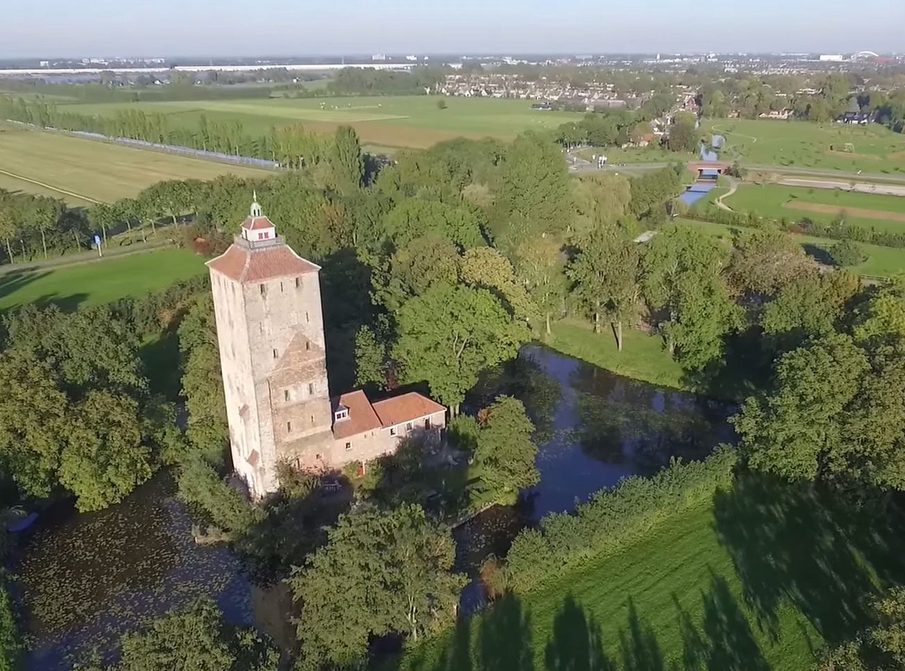
VHF and Height - USB
Same as FM, but because of the mode the range is greater on USB/Digital
Although there are some who FM-DX; An opening is best realized on USB/Digital
VHF Propagation and Scatter affects range dramatically in USB/Digital stations
Need your Horizontal antenna above the trees and as high as you can get it!
If rovering, look for hills or watertowers for high land!
At Ground level on the island - Who can talk farther to the North? FM or USB on 2m? – Height is better

Slide 9
Advanced Topics
Satellites
Meteor Scatter
EME
VHF POTA
VHF Contesting

Slide 10
Satellites!
Randy Wing, N0LD

Slide 11
Affordable, Challenging Satellite operation
“National Parks on The Air - Satellite Activation #2 - Blue Ridge Parkway – YouTube”
The first time you see someone use Satellites to make a ham radio contact:
  What just happened!
  I had not idea I could do that!
  Wow! I want to try that!
  What do I need to buy to try that?
Why operate satellites?
  Rewards small efforts to improve
  Rapidly improves your operating skills
  Guaranteed to make your neighbors wonder about you!

Slide 12
Affordable, Challenging Satellite operation
See attached Amateur-Radio-Satellites-V1.pdf

Slide 13
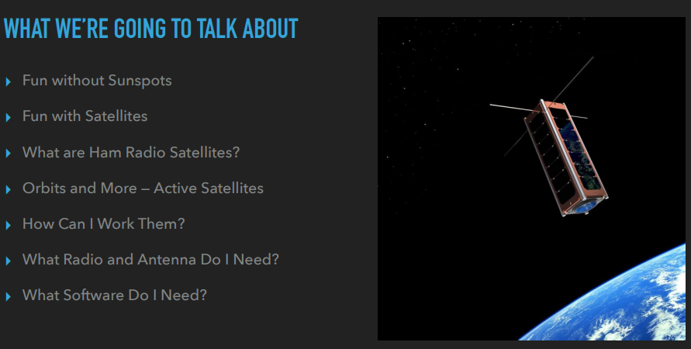
K5ND, Jim Wilson
Satellite Briefing
See attached Amateur-Radio-Satellites-V1.pdf

Slide 14
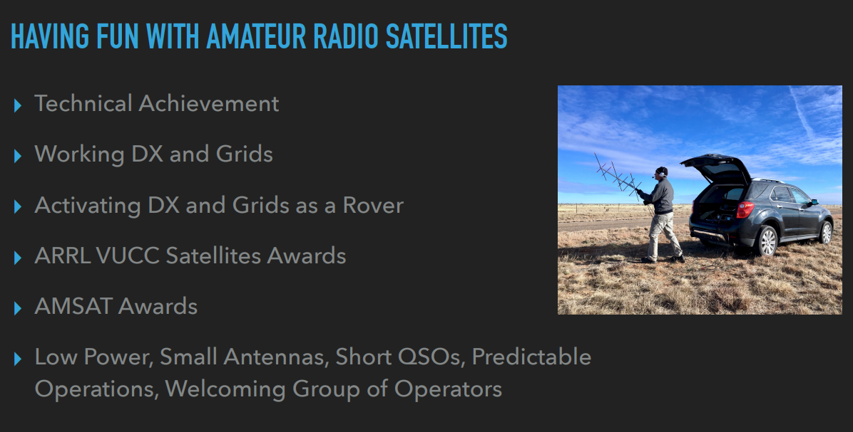

Slide 15
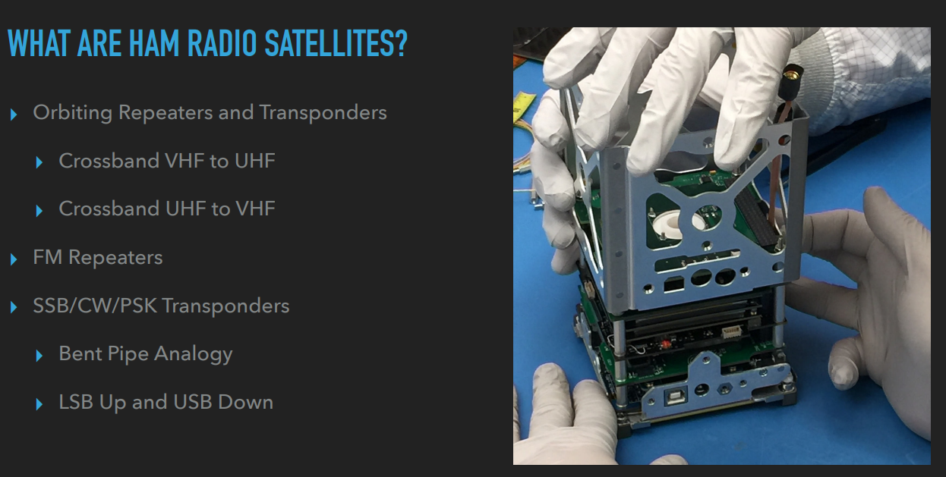

Slide 16
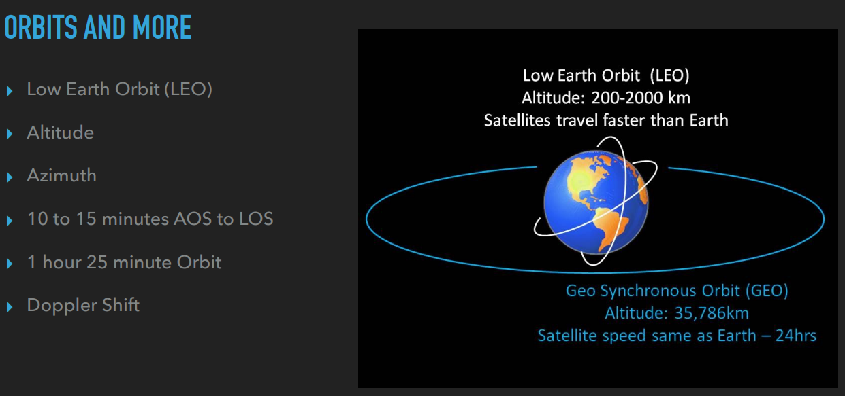

Slide 17
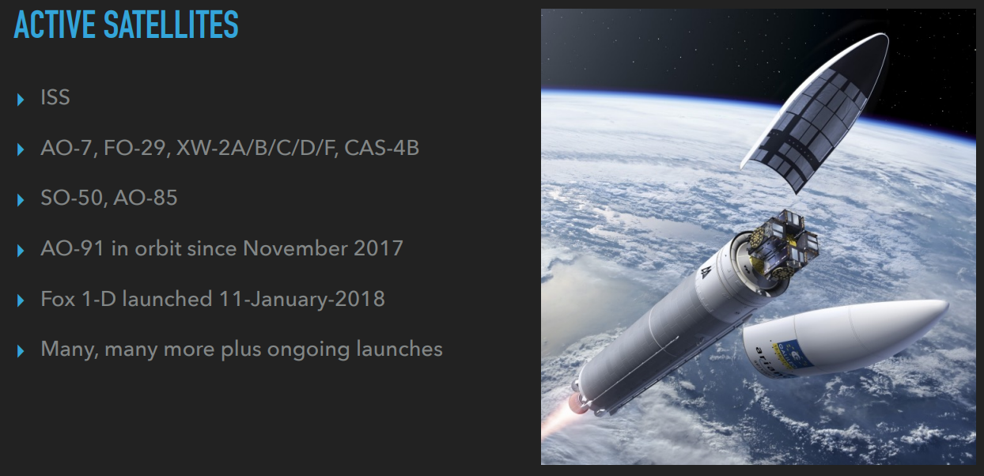

Slide 18
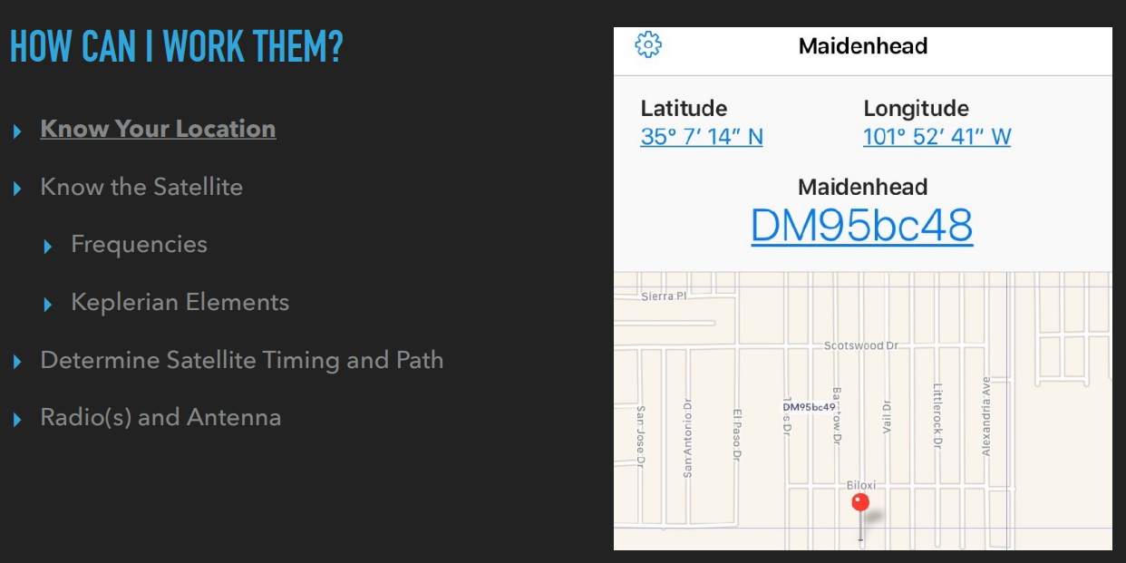

Slide 19
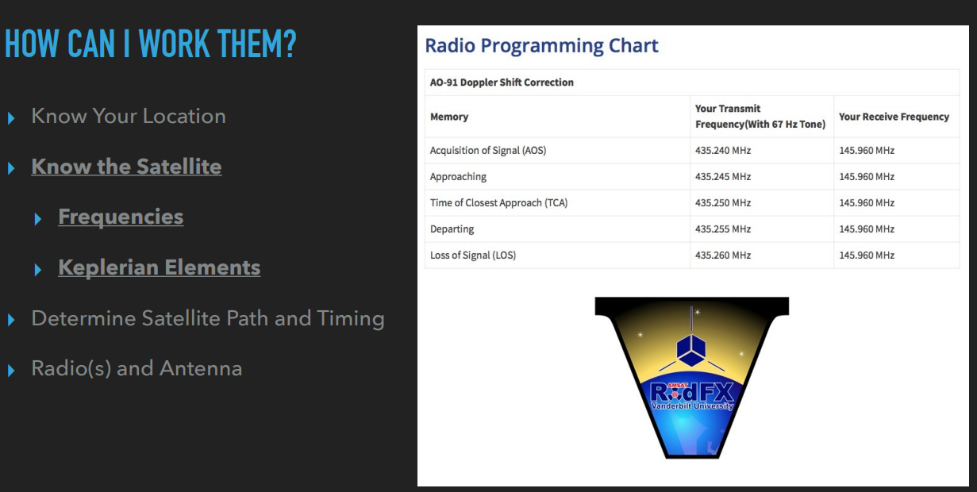

Slide 20
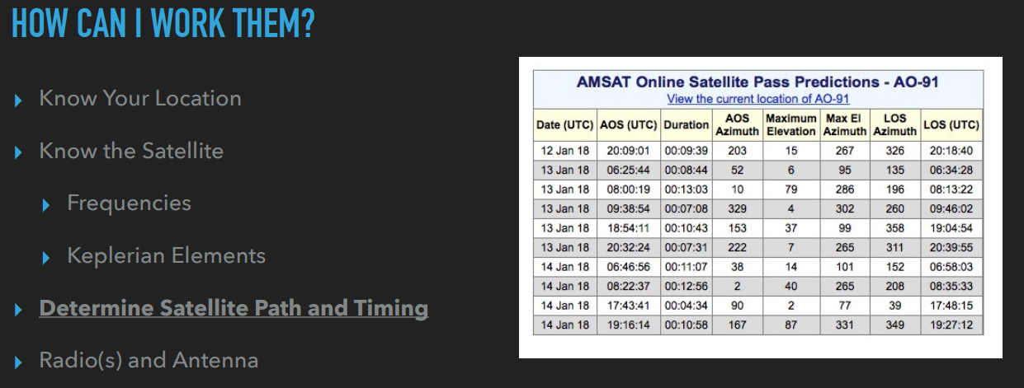

Slide 21
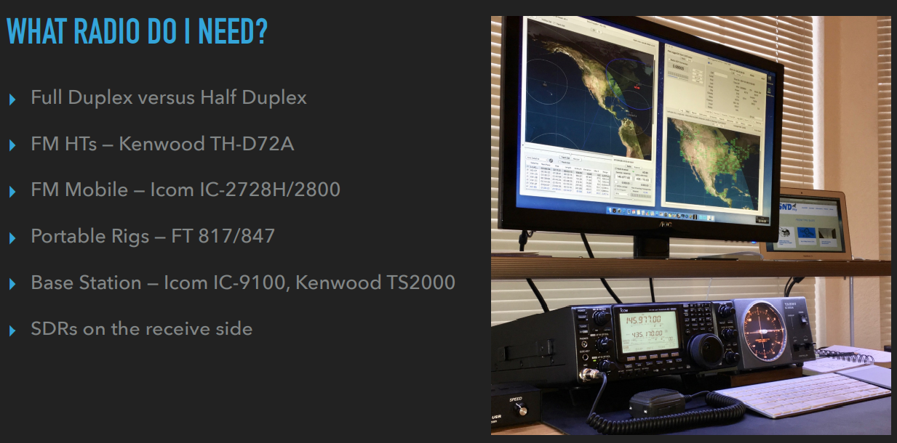

Slide 22
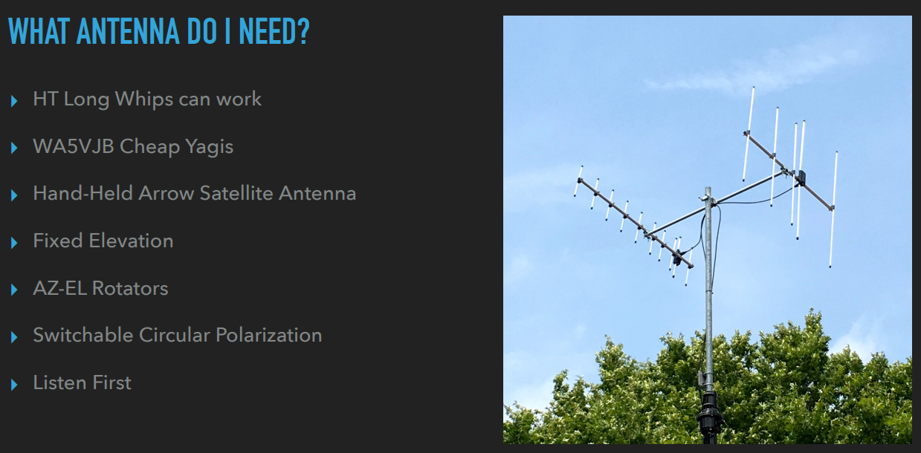

Slide 23
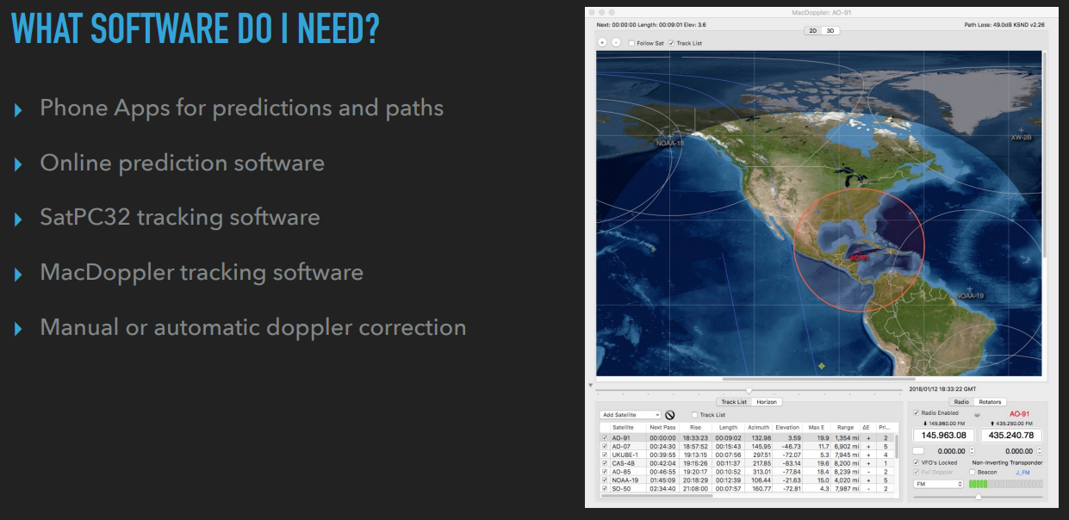

Slide 24
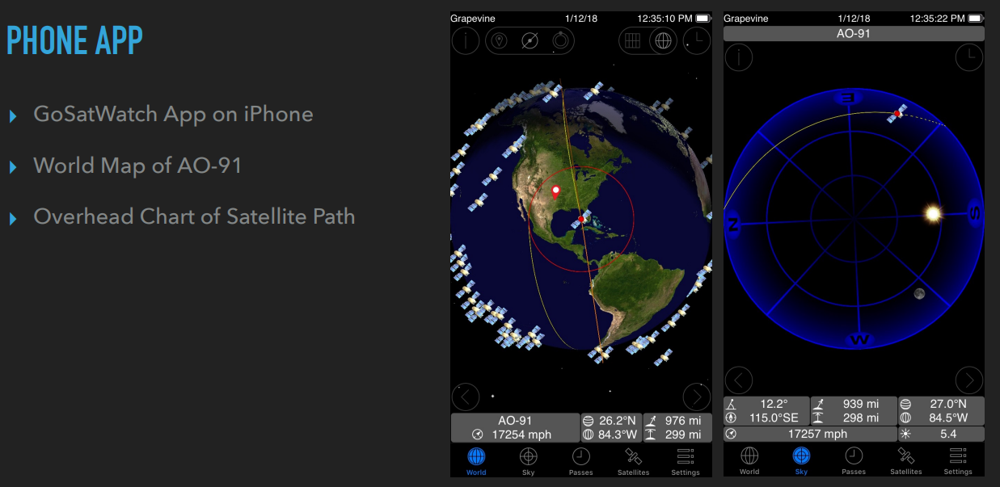

Slide 25
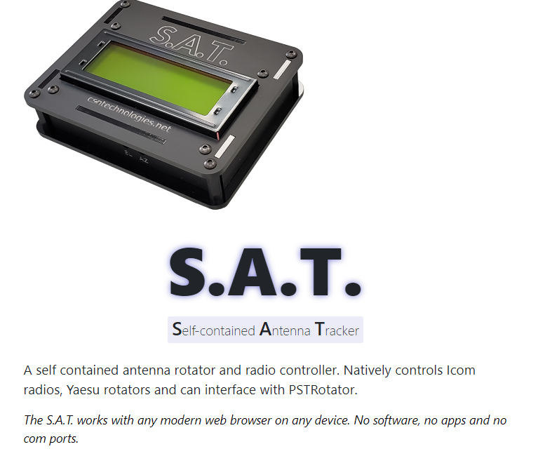
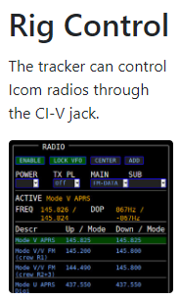
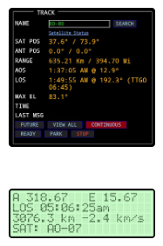
S.A.T. by CSN
Just purchased
Easy to Install / Integrate
Affordable ~$250

Slide 26
Meteor Scatter
Randy Wing, N0LD

Slide 27
Meteor Scatter
Introduction
“10 Meter Meteor Scatter QSO - YouTube”
Similar to 6m FT8, just use the MSK144 mode
  WSJT or any digital program with MSK144
  You can make verbal qsos / CW qsos on 6m – if you are fast!
Why operate meteor scatter?
  Easy - most months have a meteor shower that can result in contacts
  Easy - If you can operate WSJT-X, you can do meteor scatter!
  Rewarding - Paper chasing – FFMA, 6m VUCC, 2m VUCC. Etc.

Slide 28
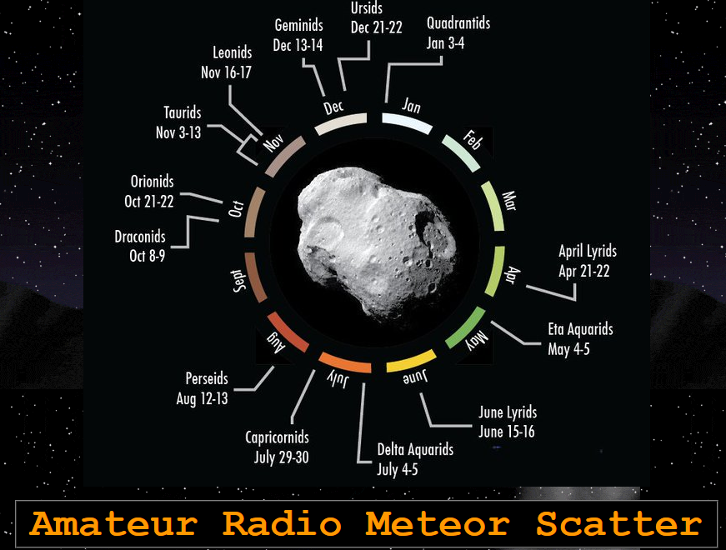
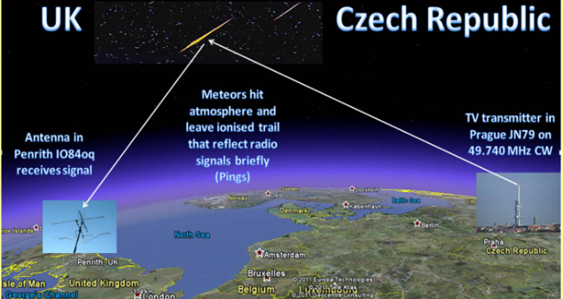
How and When
Meteor Scatter Works
G0ISW Meteor Scatter (qsl.net)
Get on the “rocks”!

Slide 29
Meteor Scatter
What do I need? Why Should I?
“10 Meter Meteor Scatter QSO - YouTube”
Similar to 6m FT8, just use the MSK144 mode
  WSJT or any digital program with MSK144
  You can make verbal qsos / CW qsos on 6m – if you are fast!
What do I need?
  Radio capable of VHF all mode operation – preferably 6m, then more
  6m Loop or even a dipole M2 6m Loop – gain helps
  You can try other bands, 2m is popular, people experiment on 1.25m and 70cm
Why operate meteor scatter?
  Easy - most months have a meteor shower that can result in contacts
  Easy - If you can operate WSJT-X, you can do meteor scatter!
  Rewarding - Paper chasing – FFMA, 6m VUCC, 2m VUCC. Etc.

Slide 30
EME
Randy Wing, N0LD

Slide 31
EME – the Challenge!
Portable EME moon bounce setup – YouTube
If you setup a sked with a large station EME you can operate moonbounce with a 12 ft 70cm antenna, 100 watts, and WSJT-X using the JT65 mode
More antennas in tandem vastly improves performance!
More power vastly improves performance!

Slide 32
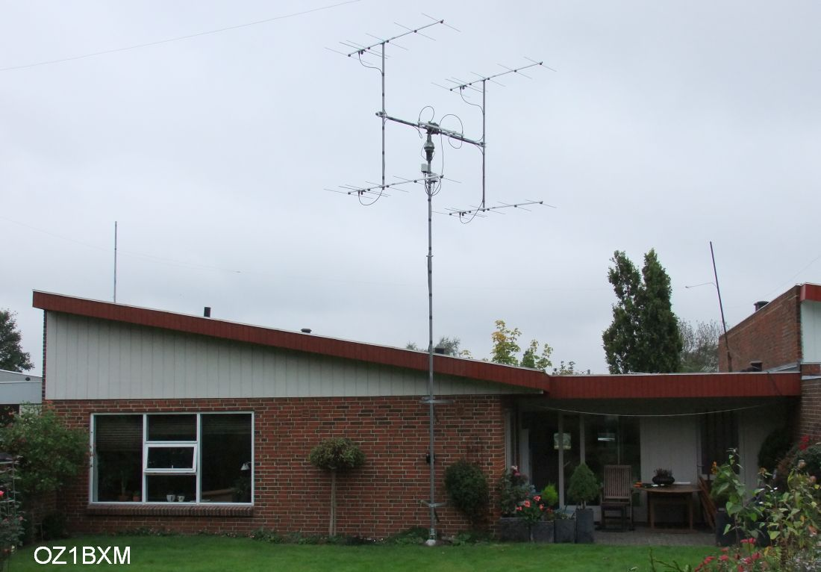
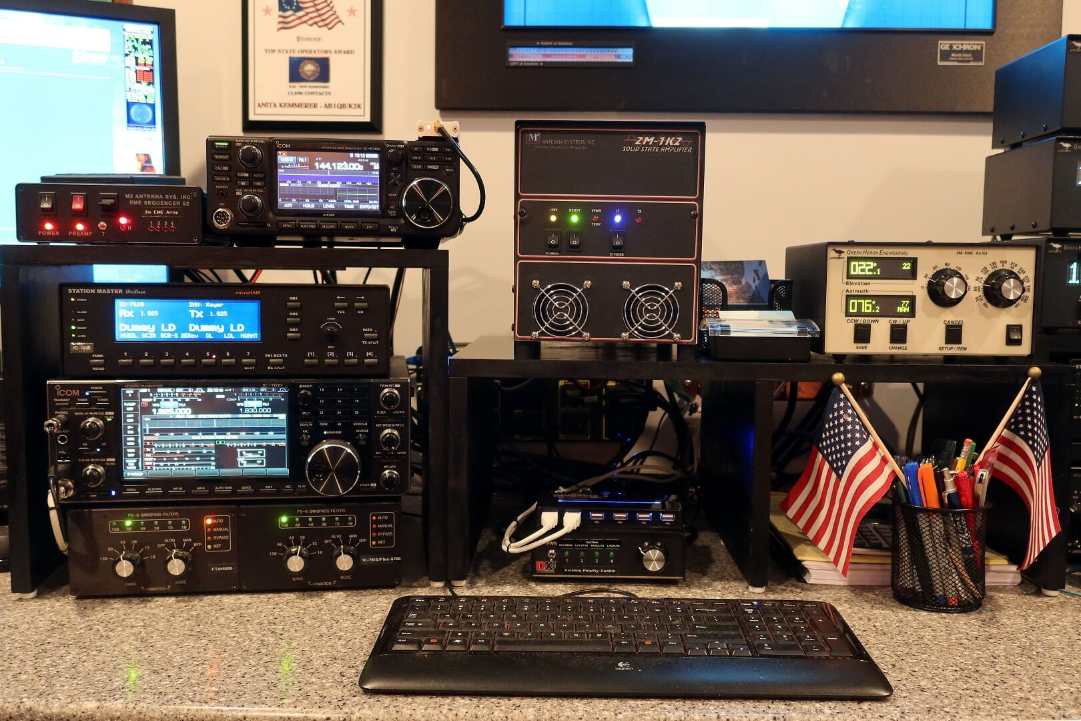
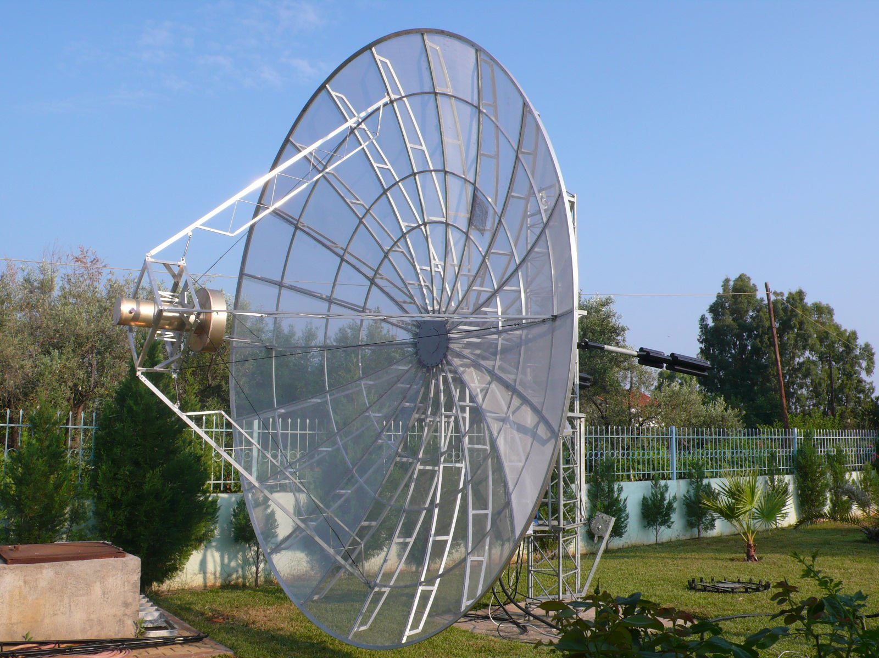
Typical EME Stations

Slide 33
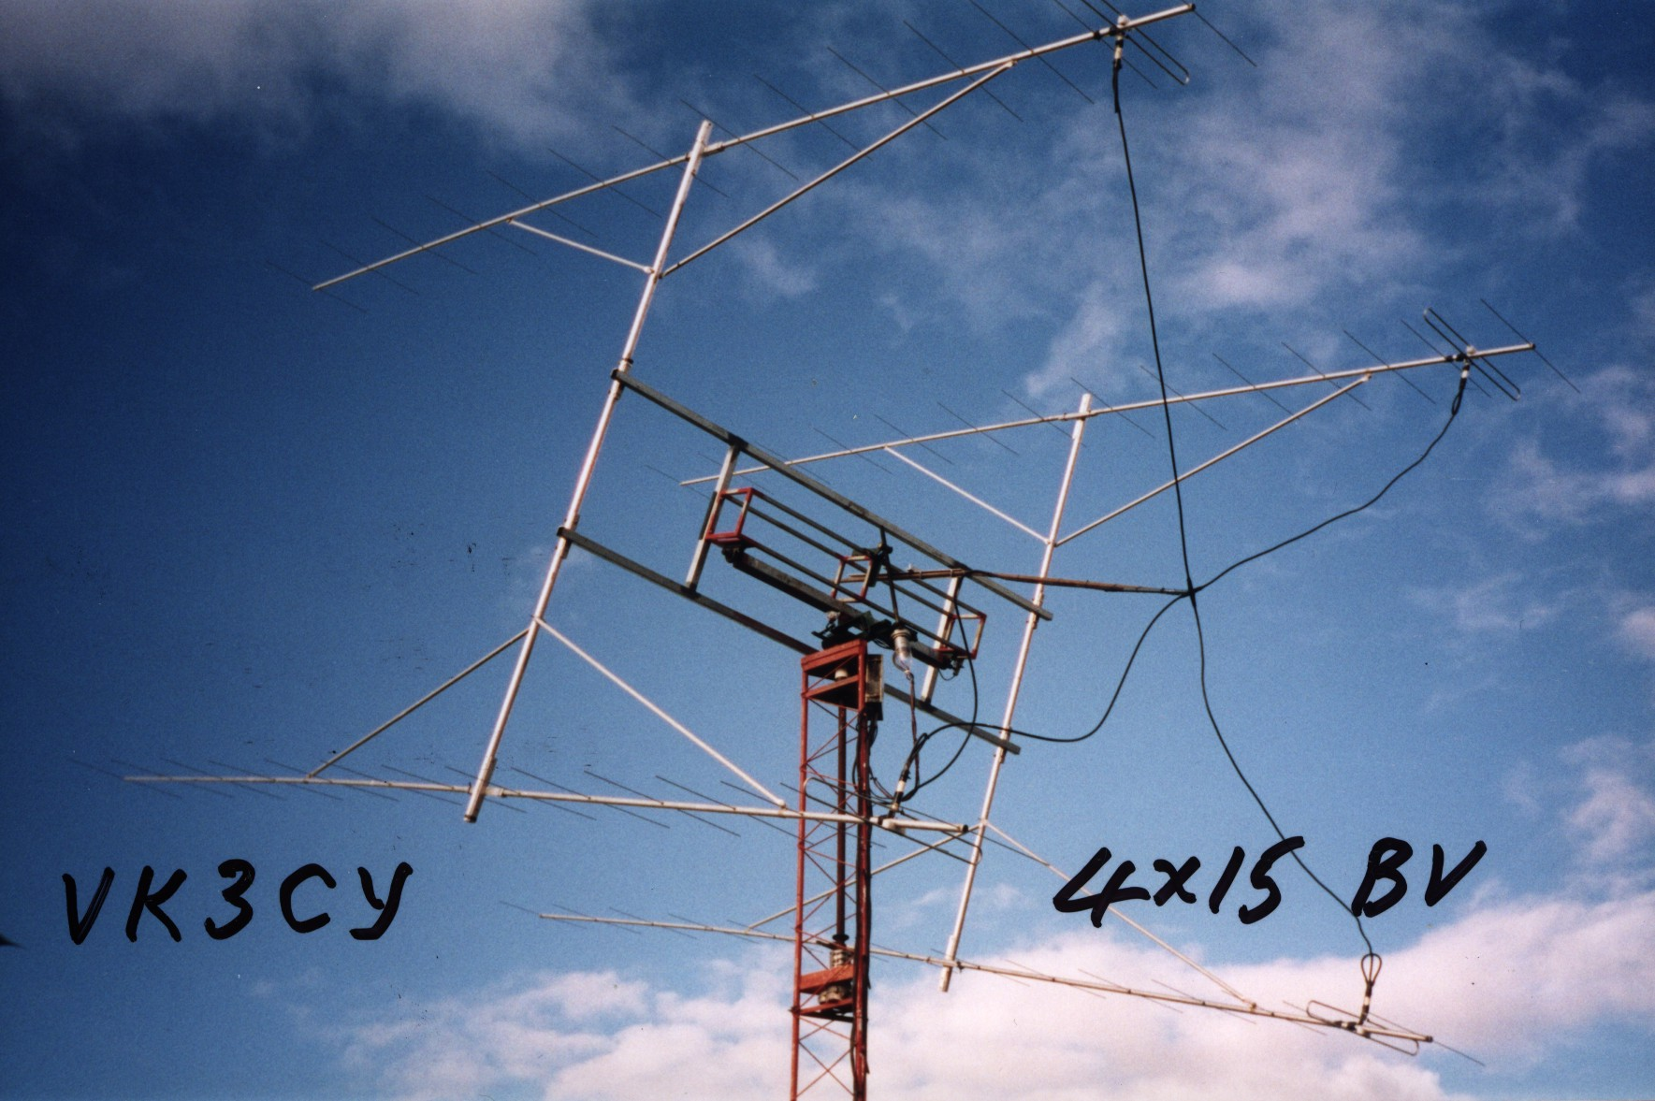
Closeup

Slide 34
VHF POTA
Credit to Marcus Sutliff, N5ZY
Full story on: Parks on the Air – N5ZY (https://n5zy.org/parks-on-the-air)

Slide 35
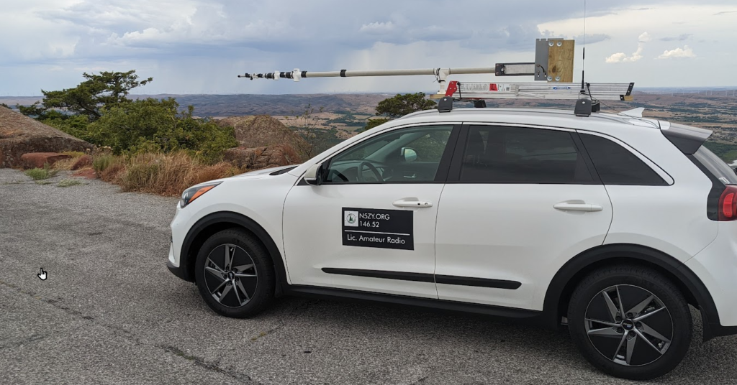
OK POTA – N5ZY
20-Aug 2022: My first park activation, K-0493, GRID EM04 Wichita Mountains Wildlife Refuge & Mt Scott Project

Slide 36
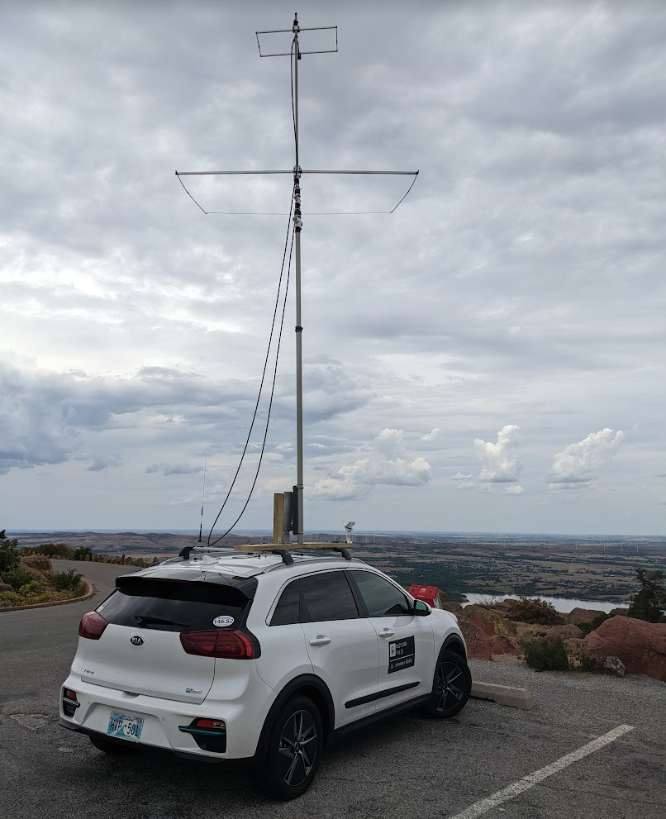
Deployed N5ZY Rover
On the air with 2m and 6m Moxons from PAR Electronics
Omniangle Antennas | PAR Electronics | loop | vhf uhf loop antenna | weak signal HO loop

Slide 37
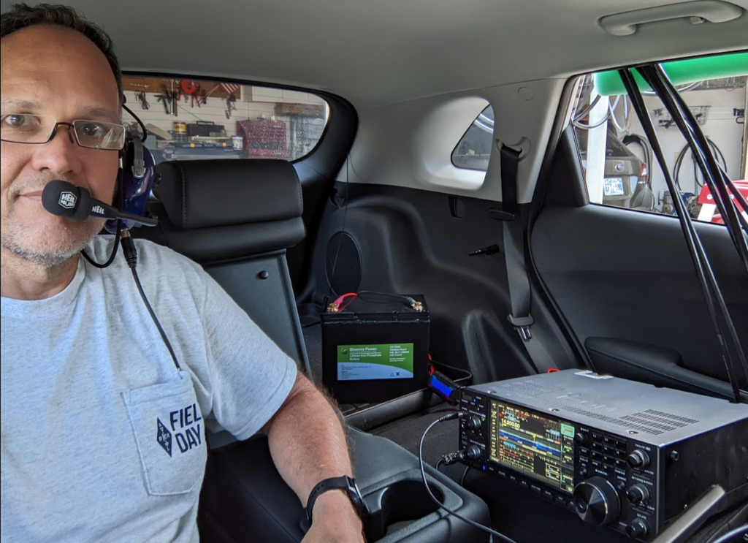
Inside the
Rover

Slide 38
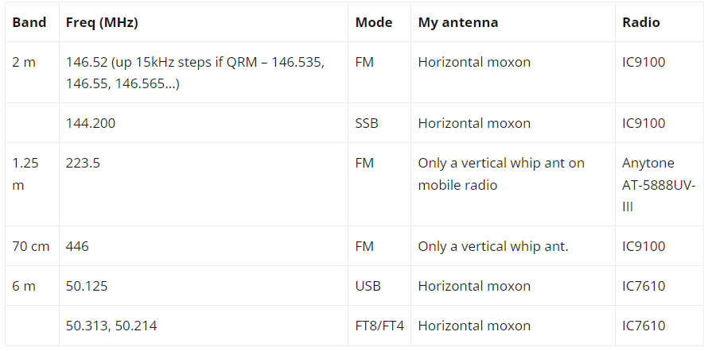
N5ZY
VHF Operating Conditions

Slide 39
Construction
Many details on the N5ZY website (aforementioned)
Design rules:
Read your vehicle’s roof rack load limit!
It’s not how fast you can drive, it’s how fast you can stop with everything still attached. Most cars use friction clamps for the roof rack and in an emergency stop you may overcome the friction holding them on! Go lightly, and keep as much weight as low as possible.
Remember that if something comes loose it could kill someone. Be mindful of safety and inspect at every opportunity.
Do not drink and drive because then using it as a jousting rod may seem like a great idea.
Do not have two horizontal masts as they could resemble blasters and invite Imperial stormtroopers to attack.
The mast is an MFJ-1906H. (Note: DXE-TCFP-33HD is a new Carbon Fiber version of the same thing! This wasn’t available in July!)
The tilt base is the DXE-VA-BASE
I also added the wing nut knobs, DXE-AOK-TB1193

Slide 40
VHF Contest Fun!
Randy Wing, N0LD

Slide 41
What is VHF Contesting?
Competing with other Amateur Radio VHF operators
Weak Signal / Horizontally polarized antennas
Higher Power the better / but many use “barefoot” power
Using 50 mhz and above frequencies
Popular VHF contests:
  ARRL Spring Sprints (50 144, 222, 432, 902 and up)
  ARRL January, June, and September VHF Contests
  CQ World Wide VHF Contest (15-16 July 2017)
Fixed, Rover, Multi-Op Categories
  Fixed: SOHP, SOLP, SO Portable, SO 3-Band (50, 144, 432 mhz), SO FM Only
  Rover: Rover, Classic Rover, Limited Rover (lowest 4 bands), Unlimited Rover
  Multi-Op: MO Limited (max 4 bands), Multi-operator Unlimited

Slide 42
Why are you here?
I would like you to consider trying VHF contesting!
VHF Contesting is increasing! ~10% increase in June 2017
Midwest and southern Plains have a lot of flat terrain! Conducive to VHF
We need more VHF contest operators to have more fun!
…and most importantly…

Slide 43
VHF Contesting is Fun!
Challenge:
  Compete with others in your “contest class”
  Can do it alone or with others
Excitement:
  Band Openings – during contests they are more noticeable!
  Helping Friends, Making Friends
  Learning – Opportunities to Mentor and be Mentored
Awards:
  Recognition from the contest sponsor; VHF contests are collaborative as well as competitive
Side Benefits:
  Improves operating skills
  Excellent preparation for emergency operations
  An excellent use of our allocated spectrum Remember: “Use it or lose it.”

Slide 44
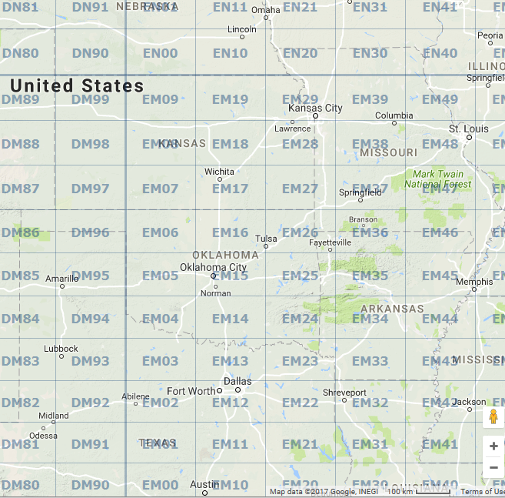
Grid Squares
Grid Squares are:
  2 deg EW; 1 deg NS
  ~100 miles x 60 miles
Example: Ardmore, OK
  EM14 “Echo Mike , One Four”
  Please copy …N0LD/R in EM14
Strategy
  Go North and South thru corners as much as possible
  (60 miles < 100 miles)
  Stay within VHF population center range
o Dodge City, KS
o Ardmore, OK

Slide 45
How Do You Score in a VHF Contest?
QSO Points (read the rules they change)
Count 1 point for each 50- or 144-MHz QSO
Count 2 points for each 222- or 432-MHz QSO
Count 3 points for each 902- or 1296-MHz QSO *
Count 4 points for each 2.3 GHz (or higher) QSO *
TIP - Work Mode that is quickest (or that you can)
Multipliers
    Total number of different grid squares worked per band
Final Score
    Total QSO Points x Total Multipliers = Final Score
* January VHF and other contests has different points

Slide 46
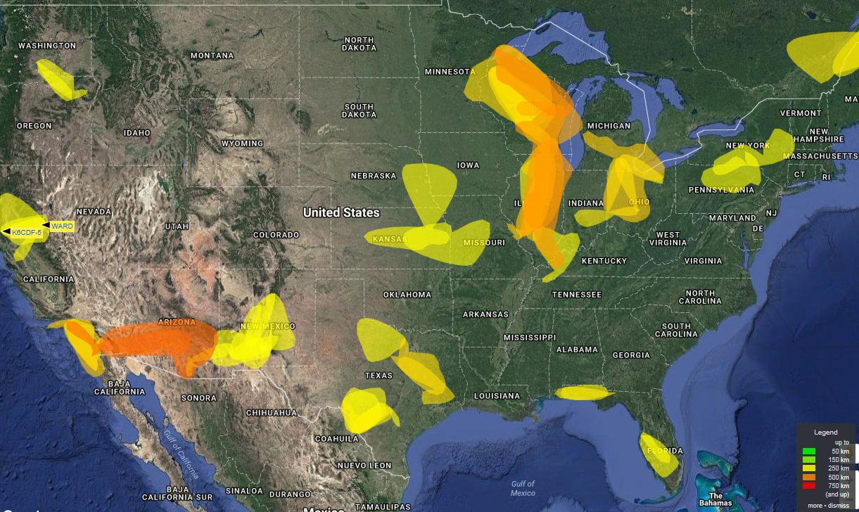
Propagation
http://aprs.mountainlake.k12.mn.us/

Slide 47
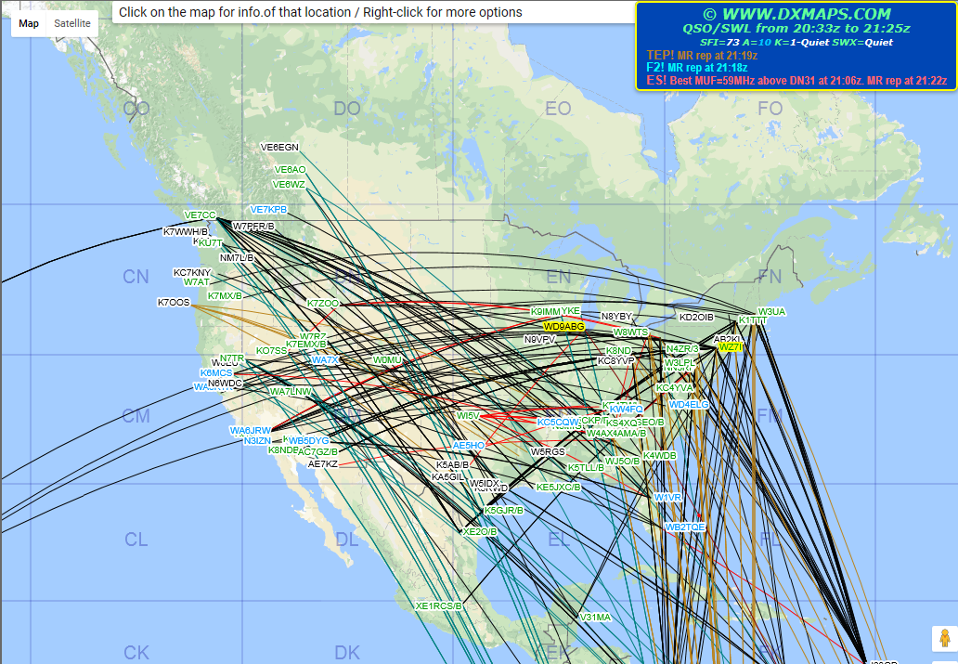
Propagation
http://www.dxmaps.com/spots/mapg.php?Lan=E&Frec=MUF&ML=M&HF=N

Slide 48
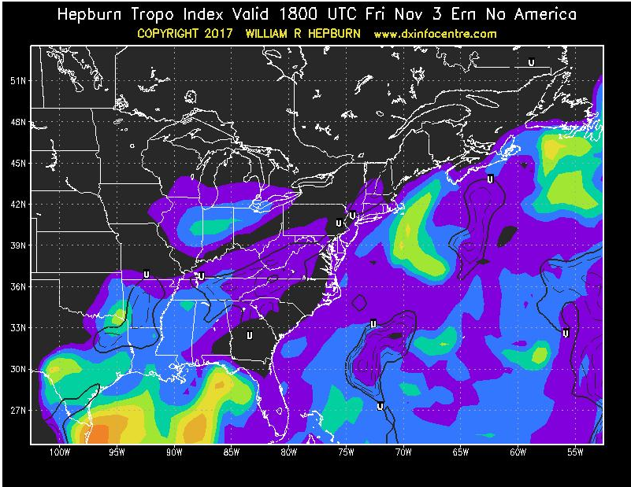
Propagation
http://www.dxinfocentre.com/tropo.html

Slide 49
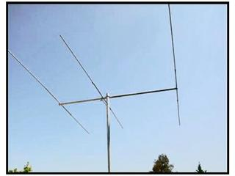
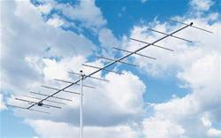
What do I need to start?
Recommend a small 6m Beam and a 2m Beam ~ $200 each
Recommend a used radio such as FT-100, FT-857D < $600

Slide 50
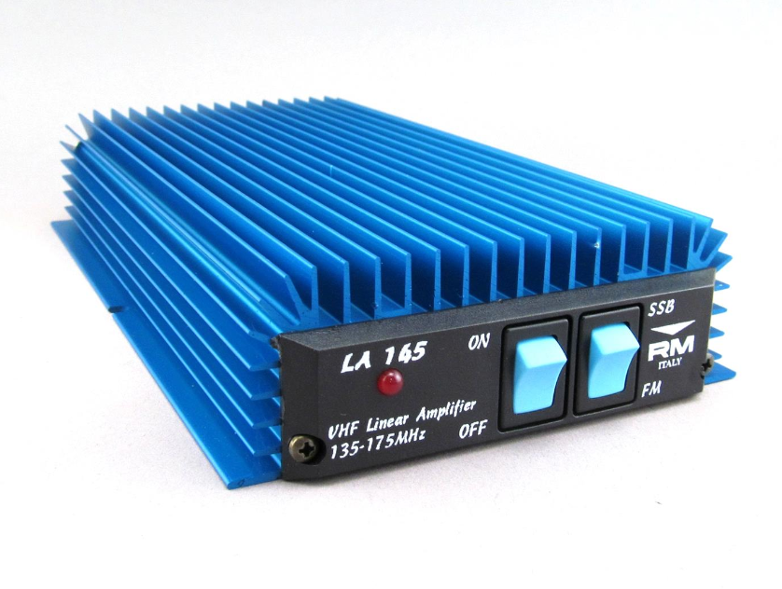
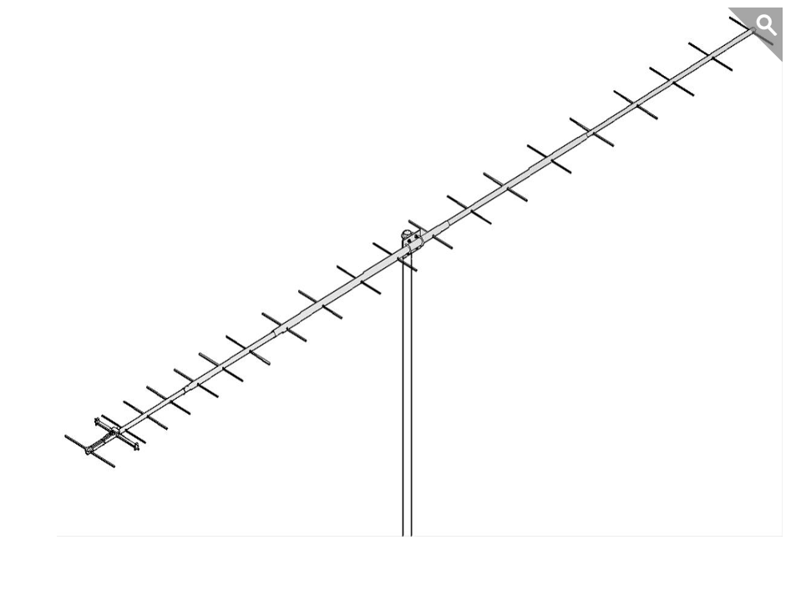
Where do I go from here?
Recommend a 70cm gain antenna ~ $230 each
Recommend a 2m amplifier (85W) < $160

Slide 51
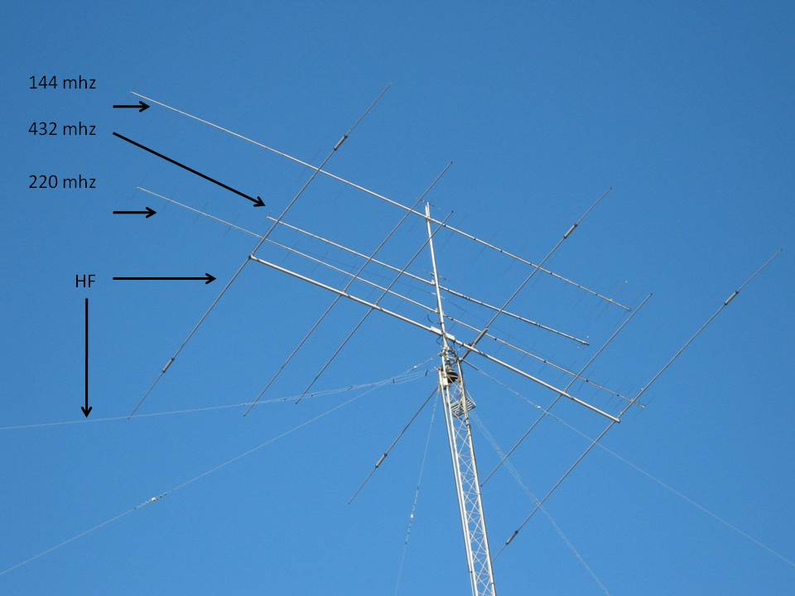
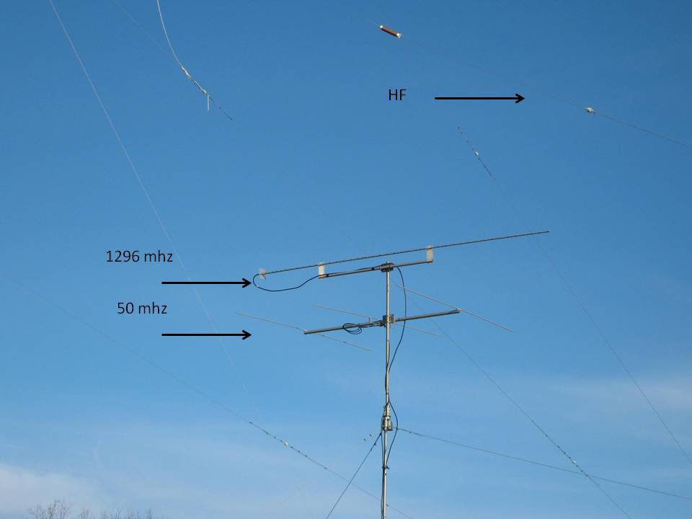
Fixed Operation Antenna Examples
No matter what size station you’re operating, it’s a thrill to talk to somebody far away.

Slide 52
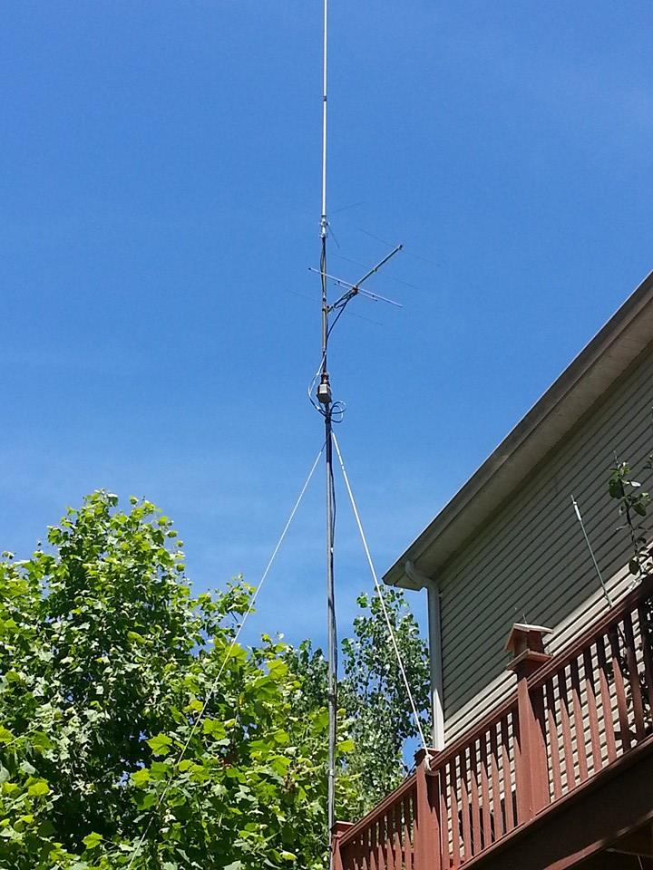
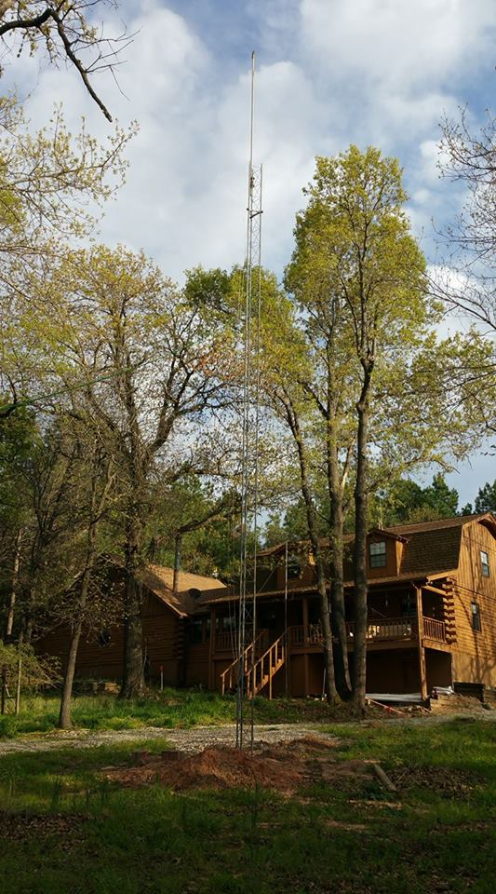
Fixed Operation Antenna Examples (more)
You’ll improve your VHF operation – just START!

Slide 53
Do I Have to Have a “Contest Station”?
Big Gun contest stations
  Multiple radios
  Multiple towers
  Serious station automation
Small Gun – Big Fun stations
  There are opportunities for “guest operating” if you have a big gun nearby!
  Ask your club members to all get on the air on 146.52 FM!
  If there isn’t anyone on, right now – try again several times later!
    Band conditions change things!
You don’t have to be a Big Gun to have Big Fun contesting!

Slide 54
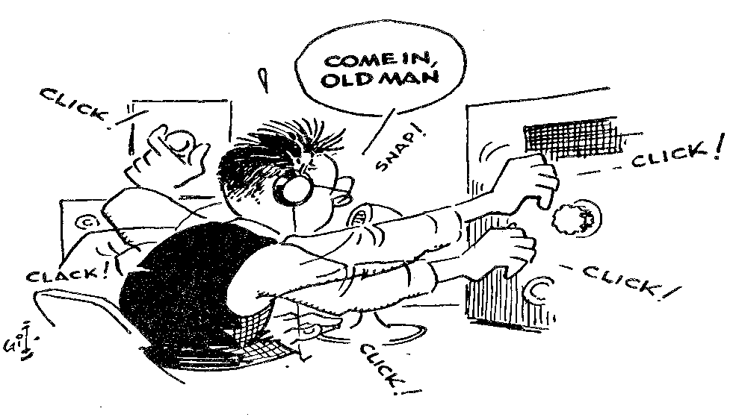
Who enters a contest? Why?
The Casual Contester
  A desire to just have some fun, improve operating skills, and work new countries, states, counties, etc. from the smorgasbord of participating stations
The Feisty Contester
  A desire to compete
  … individually, or as part of a club.
The Committed Contester
  Able to leap tall buildings with a single bound
  Able to master the art of sleep deprivation
CQ Contest!
Contesting can be like this sometimes!

Slide 55
How to Win a Contest
Choose the “Class” to match your goals!
  Limited, Unlimited, Rover (classic, limited, unlimited), Single-Op, Multi-Op, LP/HP
Work a lot of stations
Work as many “multipliers” as possible
Work smart
  Make email/telephone contacts with potential contacts – get the word out!
  Make good band change decisions
  Use efficient operating techniques
    Don’t waste time or words (similar to emergency operations)
    Know when to “Run” and when to “Search & Pounce”
    Know when to take a break

Slide 56
N0LD/R and K5SRT/R Team Up! (cont.)
Tactics!
  Used all the bands that we have radios for!
    N0LD/R already had 6m, 2m, 1.25m, 70cm, & 23 cm - added 33cm Alinco FM handheld
    K5SRT/R already had 6m, 2m, 1.25m, 70cm – added 33cm and 23 cm FM handhelds
  Used as many antennas as we could come up
    N0LD/R
      6m Loop, 2m and 70cm dual loops, 2m / 70cm vertical - added 33cm vertical ($8!)
      2m, 1.25m, 70cm, 23cm – 10 ft long yagis - added 33cm beam (7 ft long – 80$)
    K5SRT/R
      2m, 70cm verticals - added 6m and 33cm vertical – used 23cm adapted radio rubber antenna
      2m, 1.25m, and 70cm loops - added 6m loop ($180)
      2m (3 elements), 70cm (5 elements)
  TIP – During contest what is the best radio and antenna? The one that’s used

Slide 57
K5SRT/R
Configuration
For September 2018 ARRL VHF Contest

Slide 58
K5SRT/R - Antenna and Radios Diagram

Slide 59
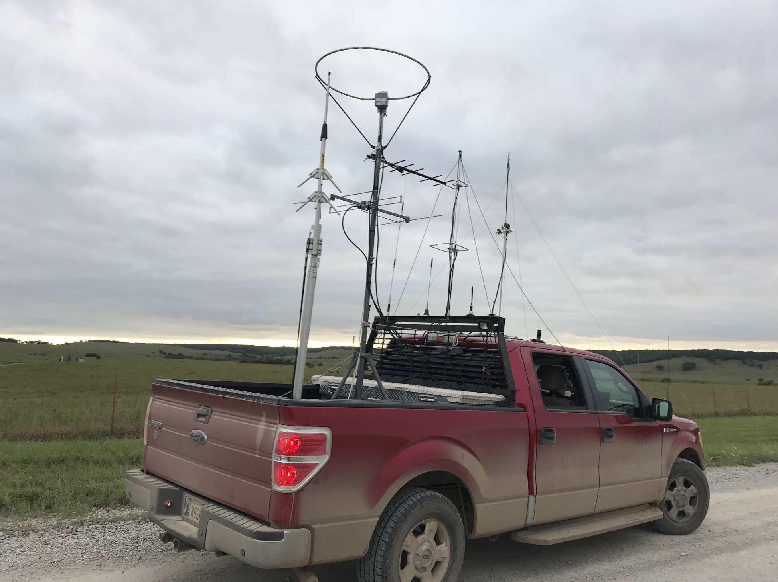
K5SRT/R Sept. 2018 Rover Hill Top
70 cm Yagi
6M Loop
2M Yagi
1.25M Loop
70cm Vertical
Flag Pole
2M Loop
70 cm Loop
2M/70cm Vertical x2
23M Vertical Rubber Duck
23M Vertical Stub
6M Vertical Ham Stick
33M Vertical Stub
*2M/70cm Vertical (Front Left Not Seen)

Slide 60
K5SRT/R Equipment, Tips, & Notes
Remain flexible - Things change!
  Not everything goes the way you plan: Light vs dark, good vs bad weather, equipment operational/no operational, propagation open/closed, team may need a break, frequency or equipment interference
  Take notes/Build a list of things to improve on the next trip
Monitor, give calls, and share contacts and frequencies with others
  VHF Contesting is friendly and collaborative – keep the spirit going! Elmer!
Work where people are (FM simplex, SSB, Digital, and antenna type)
  FM Simplex is a great way to pick people up – and it is OK to solicit people on local repeaters!
Be helpful and encourage others
  everyone can learn something or improve
Start coax installs from the operators perspective
  Store excess coax and equipment spares outside of the operators position

Slide 61
K5SRT/R Equipment, Tips, & Notes
Start Planning Early!
  We start planning at least two months before a contest!
  Have plans, do test runs, have maps (electronic and paper), alternate routes and use visual aids for operational awareness (helpful during a Grid Dance)
  Build checklists for installation, beginning the contest, Grid Dancing, and supplies
  Consider this rover as the practice run for your next!
Communicate clearly so that your logger can be accurate
  Don’t go faster than they can log; no need to make the loggers life miserable!
Change position
  Let the other people in your car drive, operate, log – it will improve everyone’s enjoyment
Capture and document before, during, and after the event
  Your antenna configuration, your coax, your switches, your power, everything!
  Capture your configuration in pictures as well

Slide 62
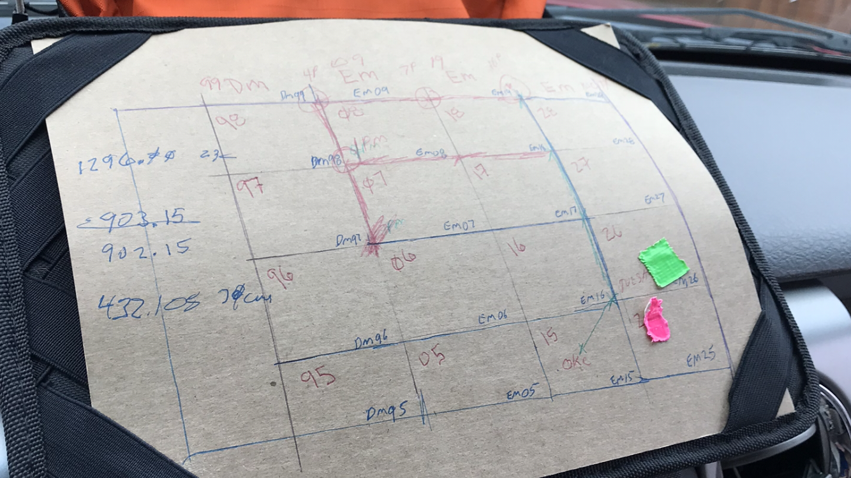
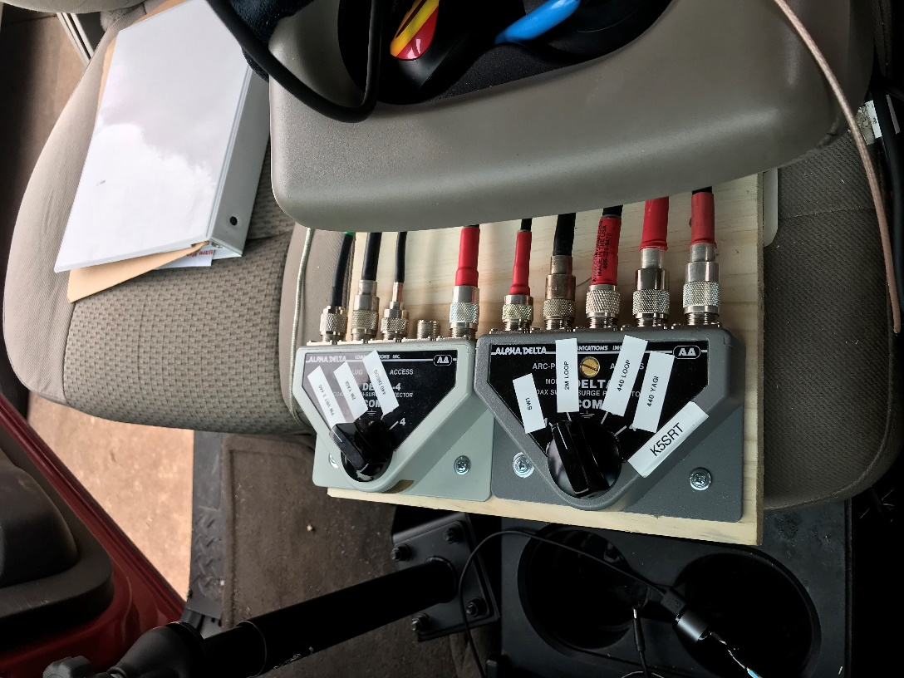
Visual Operator Aid & Remain Flexible
MAPS
EM26
EM25
Add additional antenna options, test & verify your configuration

Slide 63
K5SRT/R Electrical Power Diagram

Slide 64
K5SRT/R Power Diagram Notes
Alternator & Battery (source and connections)
Safety fuses for protecting wiring and equipment
AC & DC (Four Position) Master Power Switch
  Off, AC Only, DC Only, Both AC & DC
  Added LED red lights to enable awareness if equipment is powered
Use what you have and improve things based on a plan.
  Son gave me a 1500 Watt Inverter, N0LD loaned some equipment
Look for flexible things
  AC Power Strip has 2- USB ports in addition to outlets for PCs this also free up vehicle power points
Anderson Power Poles or standardized installation connections
  Allows you to add or change components easily
  Allows you to add a team member at the last minute that has additional equipment
Watch for interference, loose power, and ground connections

Slide 65
N0LD/R
External Rover Setup
For September 2018 ARRL VHF Contest

Slide 66
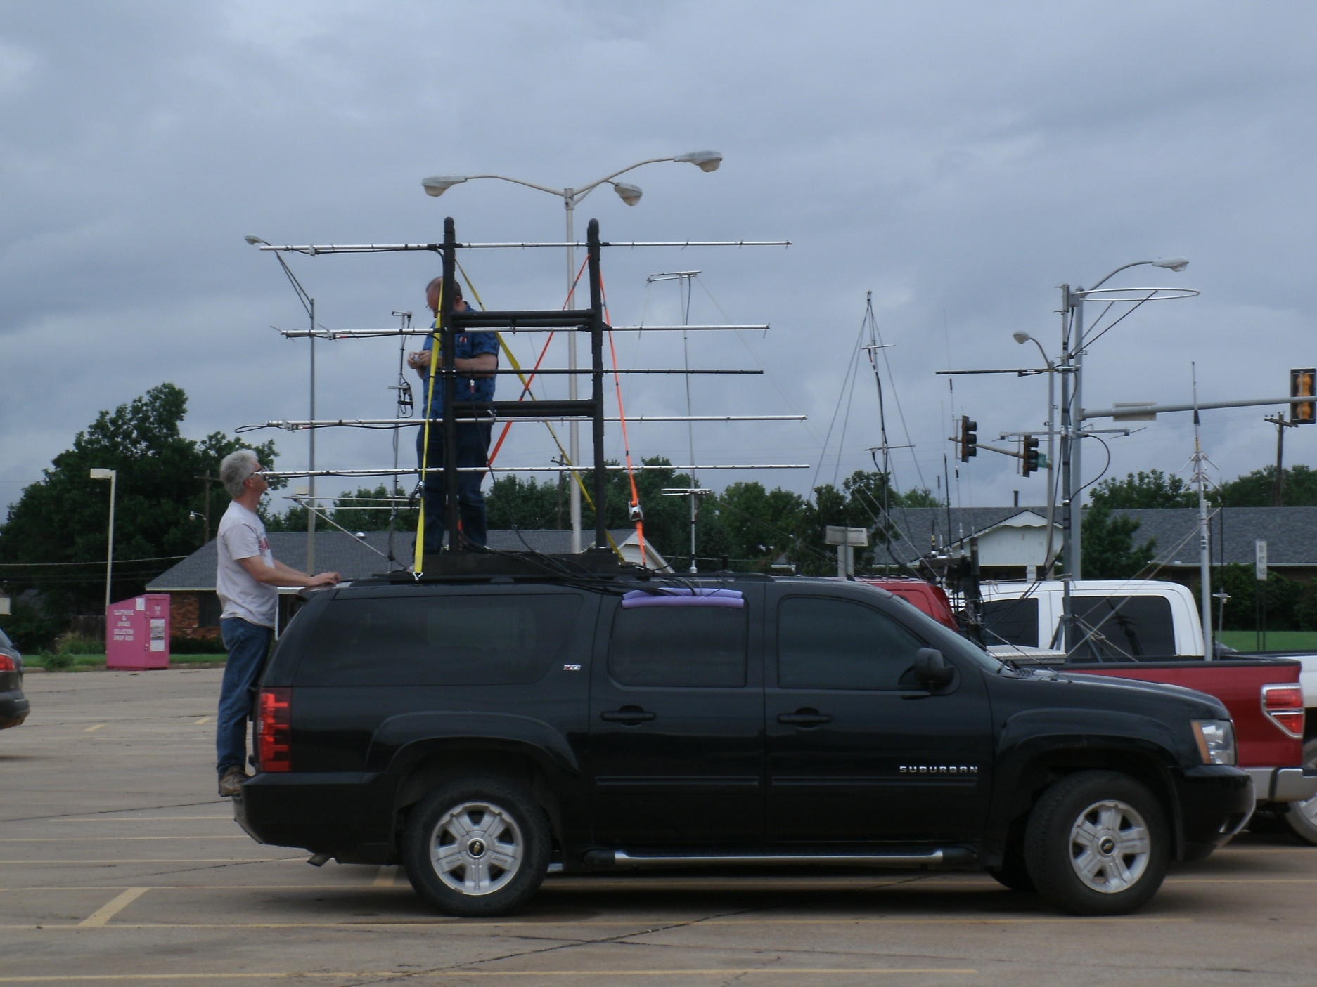
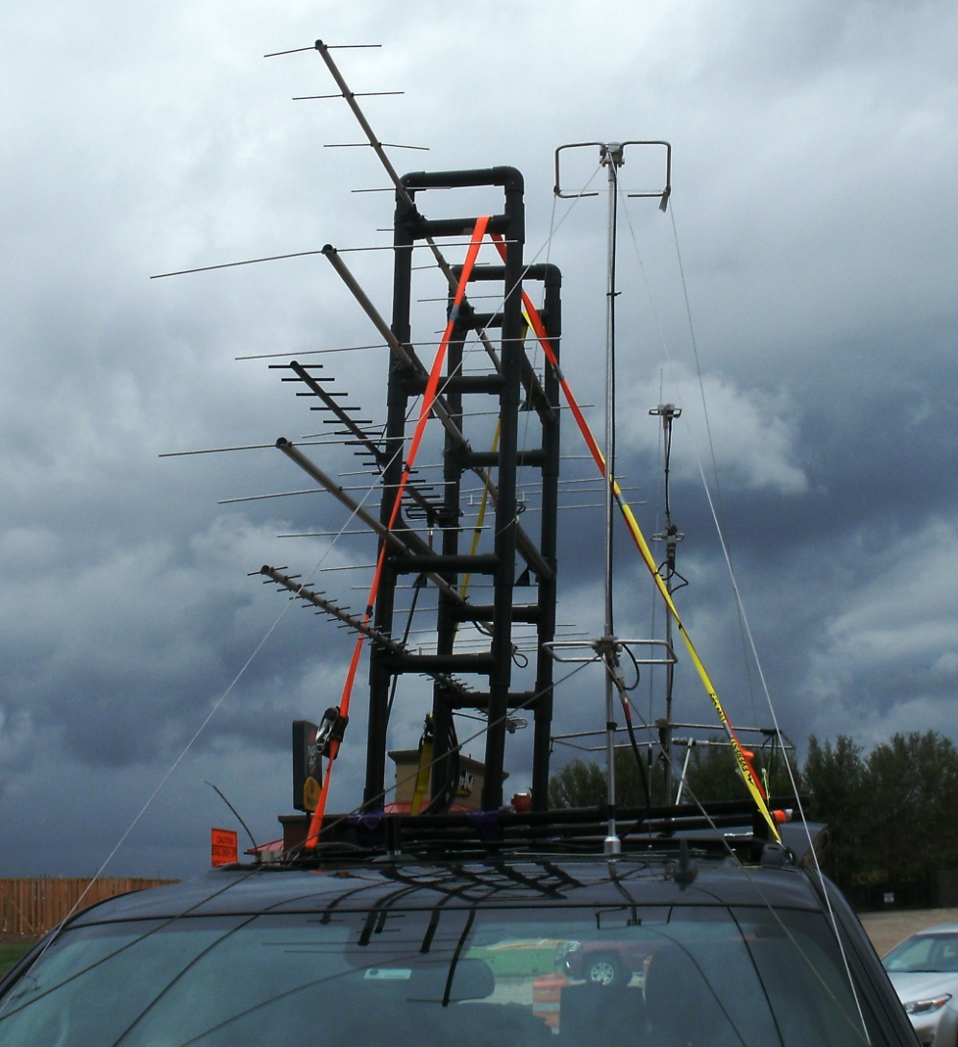
N0LD/R
2m Dual Loops
70cm Yagi
2M/70cm Vertical
33 cm Yagi
2m Yagi
70cm Dual Loops
33 cm Yagi
1.25m Yagi
23cm Yagi
6m Loop
33M Vertical

Slide 67
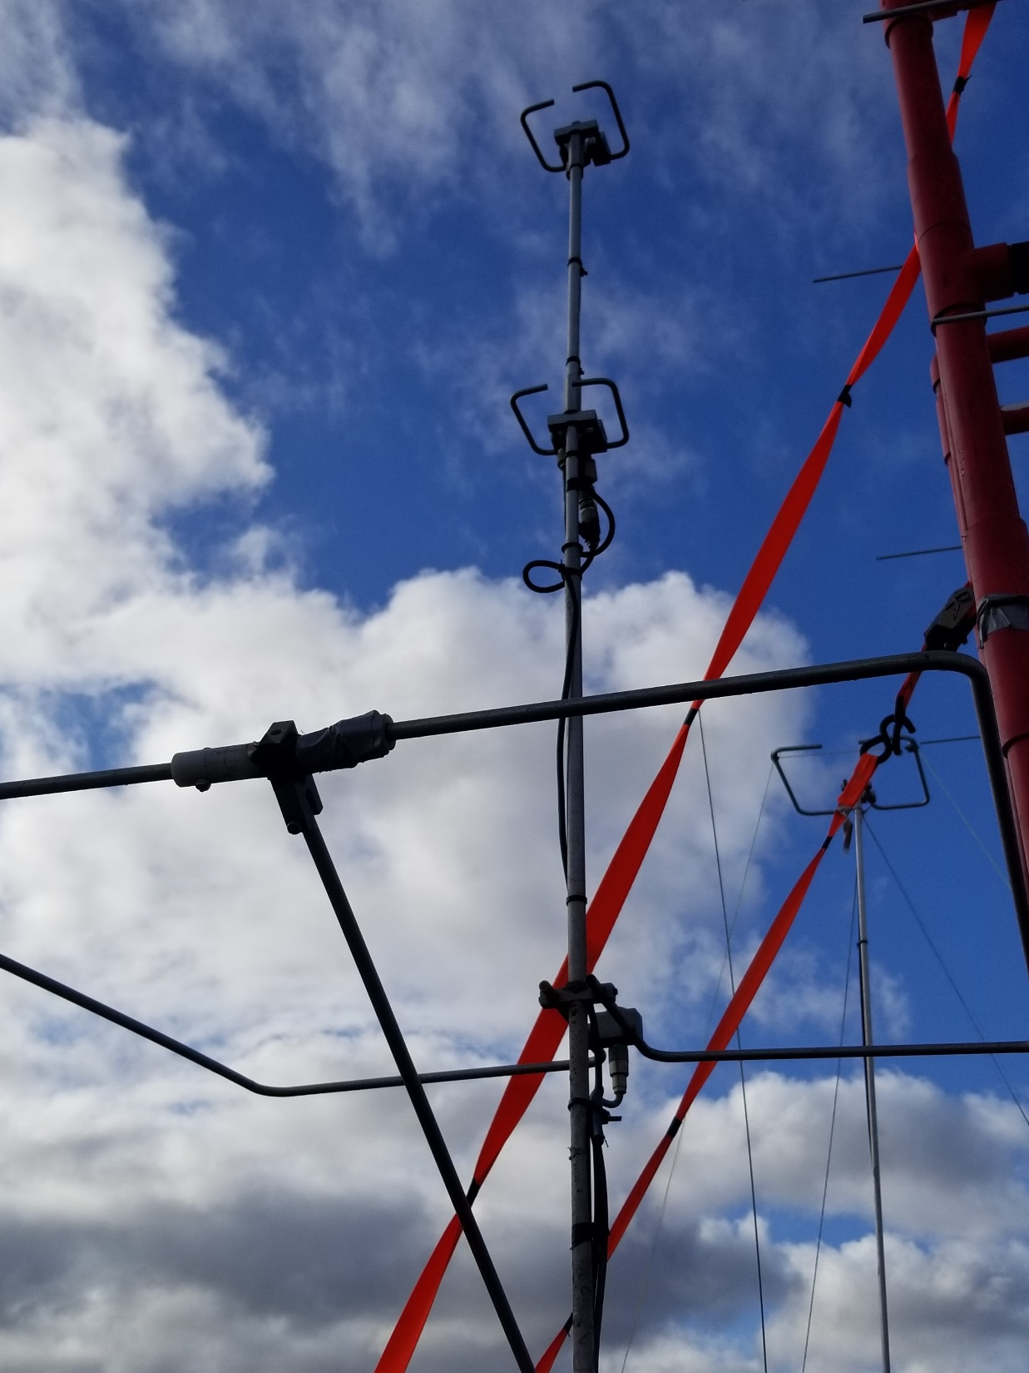
Focus on the Loops
Nom.
Yagi Range
70cm Dual Loops
6M Loop
2M Dual Loops
Nom. Loop Range

Slide 68
N0LD/R
Internal Rover Setup
September 2018

Slide 69
N0LD/R RF Architecture
6m Loop
2m / 70cm Vertical
Dual 2m Loops
2m Beam
1.25m Beam
Dual 70cm Loops
70cm Beam
33cm Vertical
33cm Beam
23cm Beam
2m Switch
70 cm Switch
33 cm Switch
Power Meter
Power Meter
Power Meter
150 W 2m Amp
100 W 70 cm Amp
Yaesu
FT-847
Kenwood
TM-D710A
Alinco
DJ-G29T
Yaesu
FT-736R
30 Aug 2018

Slide 70
N0LD/R RF and Power Architecture
6m Loop
2m / 70cm Vertical
Dual 2m Loops
2m Beam
1.25m Beam
Dual 70cm Loops
70cm Beam
33cm Vertical
33cm Beam
23cm Beam
Car Battery
Dual
Powr Switch
2m Switch
70 cm Switch
33 cm Switch
Power Meter
Power Meter
Power Meter
40 Amp Dist.
Voltage Upconv.
150 W 2m Amp
100 W 70 cm Amp
40 Amp Dist.
Voltage Upconv.
Yaesu
FT-847
Kenwood
TM-D710A
Alinco
DJ-G29T
Yaesu
FT-736R

Slide 71
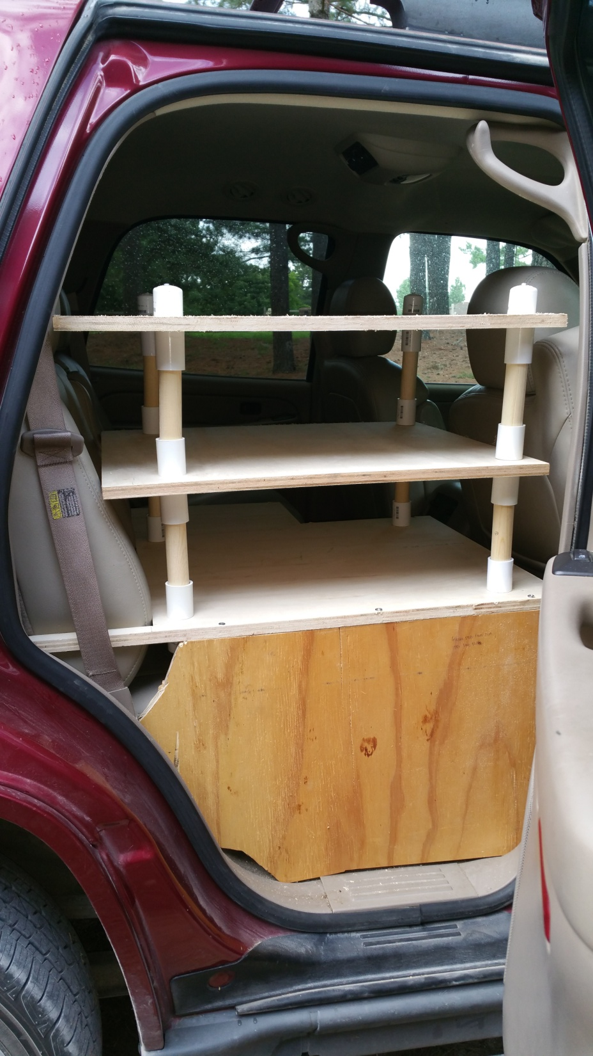
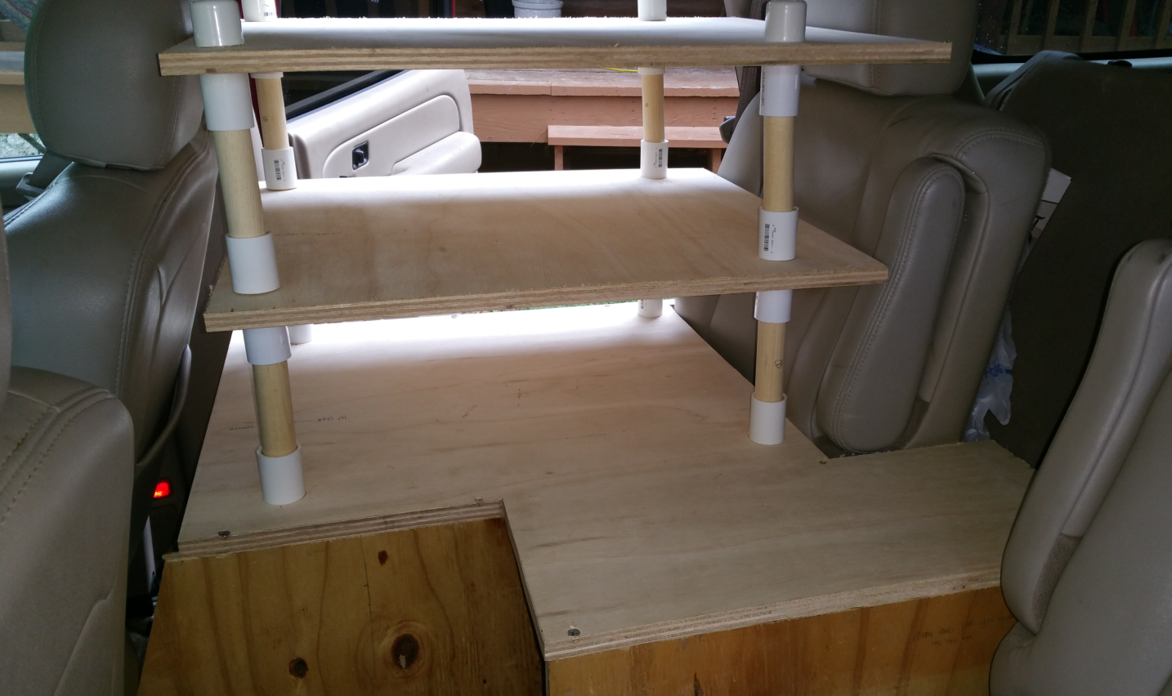
Lego Shelves

Slide 72

AB0RX at the N0LD/R main operating position

Slide 73

Yaesu FT-847
Digital for 6m
6m Watt meter
WinUSB for CW
Yaesu FT-736r
1.25m amp – 100 watts
Power Voltage Up-converters & Dual Distribution Switches
2m and 70cm Watt meters
Power Switch
70cm amp – 100 watts
Switches for 2m, 70cm, and 33 cm (hidden)
2m amp – 200 watts

Slide 74

ICOM 9700
W0HGJ, Harvey
ICOM 7610 for 6m
Yaesu FT-736r
Front seat for 1.25m
Logging Laptop – customer software by KG9DUK
AC Power
Power Switch
Switches for 2m, 70cm, and 33 cm (hidden)
2m Digital
6m Digital Laptop

Slide 75

W0HGJ – FM and 6m Digital Operation

Slide 76

Laptop harness over seat back

Slide 77

Station 3 – FM 2m & 70cm
Pre-loaded with Repeater Frequencies specific to the rover trip
Kenwood TM-D710 radio

Slide 78
N0LD/R and K5SRT/R
On The Road
September 2018

Slide 79
N0LD/R and K5SRT/R Team Up!
How can we expand the number of VHF Rovers?
  Find interested people; take them for a ride!
  We’ve grown from N0LD to N0LD/KC0MTM to N0LD/KB0YHT to N0LD/KB0YHT/K5SRT to
  … this September’s dual rover team
Strategy – how did we win a VHF award for Rover?
  There are three categories of VHF Rover entries:
    Classic – up to 2 people; limits on QSOs w/ rovers of 100;
    Limited – up to 2 people; limits on QSOs w/ rovers of 100; only 6m thru 70cm; limited power
    Unlimited – any # of people; no limits, unlimited power
Best For Our Teams
Unlimited is not popular; not seen as true competition
To win at Unlimited – you have to “gang up” in teams!

Slide 80
N0LD/R and K5SRT/R Team Up! (cont.)
Tactics!
  Built an almost 400 person deep VHF location database
    Used our prior contest logs
    Used the logs of friendly fixed based stations
    Asked everyone for their operational status (bands, phone #, email address)
    Determine their latitude / longitude from QRZ
    Constantly under upgrade for current status
  From this - determined the VHF population centers locations

Slide 81

Developed a VHF Database
Over 250 HF hams currently in our database
Grayed squares allows cutting and pasting to Hamstermap.com
Copy grayed columns to Hamstermap.com

Slide 82

Grid Square Visualization Tool #1
http://hamstermap.com/custommap.html
Copy and replace this information with the grayed columns from the previous page

Slide 83

Grid Square Visualization Tool #2
https://k7fry.com/grid/

Slide 84

County Visualization Tool
https://www.randymajors.com/p/countygmap.html
Or Google Maps!

Slide 85

VHF Stations
Black circles are amateur radio VHF stations with 2m and 70cm and who have been active within the last 5 years
Red circles are more active amateur radio VHF stations with 2m and 70cm and 6m
Green crosses are VHF super stations – active and multiple bands
White pluses are the edges of the grid squares

Slide 86
N0LD/R and K5SRT/R Team Up! (cont.)
Tactics!
  Focused on Grid “Circling” in eastern KS and OK; started in western KS
  Plot a route close to the grid circles
    As close to North and South as possible
    Then prepare detailed full route planning:
      At each grid square
      And between the grid squares
    Include operational action queues so that new and experienced operators know

Slide 87


Slide 88


Grid Square Visualization Tool #2
http://qthlocator.free.fr/index.php?locator=EM12
and
“snipping tool”

Slide 89


Grid Square Visualization Tool #3
http://dxcluster.ha8tks.hu/hamgeocoding/
and
“snipping tool”
D
C
Dynamically calculates lat, long, and grid as you move your mouse from location to location !!!
B
A

Slide 90

DM98
EM08
EM18
Itinerary
Depart Nick’s House @ Noon on 7 Sep, 2018
Arrive Woodward for rest stop @ 2:30 PM
Arrive @ Dodge House Hotel & Convention Center, 2408 W Wyatt Earp Blvd, Dodge City @ 5 PM
DM97
EM07
EM17
DM96
EM06
EM16
EM15
DM95
EM05

Slide 91
N0LD/R and K5SRT/R
On The Road
September 2018

Slide 92

Good Morning, Dodge City, KS!

Slide 93

Itinerary – Saturday Sept 8 Morning
Sleep in until 7:30 AM; Have breakfast at 8:00 AM in the hotel or anywhere
Check out 8:45 AM
Tour local Boot Hill Museum at 500 W Wyatt Earp Blvd, Dodge City, KS 67801 from 9 AM through 11:30 AM; Depart Museum
Pick up fast food on the way out of town – one last restroom break!
Head east on US Highway 283
DM97
EM07
Wright
DodgeHouse
BootHill

Slide 94



Itinerary – Saturday Sept 8 Morning (cont)
Continue North on US Highway 283
Turn left (west) at the Jetmore Airport on F Rd
Proceed 4 miles to the west to the starting point for the contest – Point 97E in DM97!
Establish IM for N0LD/R
Arrive about Noon
Recommend calling and trying to work before 1 PM:
E
Jetmore
DM97
EM07
 | Callsign | telephone | Grid | 6m | 2m | 1.25m | 70cm | 33cm | 23cm | 13cm
 | K0BJ | 785-462-0884 | DM99kj | Y | Y
 | K0RCJ | 620-755-4826 | EM18ei | Y | Y |  | Y
 | K5ZG | 419-230-1827 | DM88 | Y | Y
 | KB0ZOM | 406-740-2114 | EN00tn | Y | Y | Y | Y
 | KF0M | 316-617-3133 | EM17io | Y | Y | Y | Y |  | Y
 | N0KQX | 620-521-0464 | DM97nx | y | Y |  | Y |  | Y
 | N0KQY | N0KQY@wbsnet.org | DM98gk | y | Y | Y | Y |  | Y
 | N0LL | 785-282-5831 | EM09os | y | Y | Y | Y
 | N0YK | 620-874-2292 | DM98ml | Y | Y | Y | Y |  | Y
 | W3DHJ | w3dhj@jonz.net | DM78rf | Y | Y |  | Y
 | W5AFY | 972-839-6992 | EM04id | Y | Y | Y | Y | Y | Y | Y
 | WQ0P | 785-213-7072 | EM19wf | Y | Y | Y | Y | Y | Y | Y
Wright

Slide 95

  Stations we might reach from western Kansas
DN80
DN90
KB0ZOM
EN00
EN10
KC3OL
AE0G
DM89
DM99
KD0ARW
N0LL
EM09
EM19
WQ0P
K0BJ
F
D
I
DM88
WA0VJR
DM98
EM08
WA0ARM
EM18
KD0EZS
N0KQY
N0YK
K0RCJ
W3DHJ
E
H
K5ZG
N0KQX
DM87
DM97
EM07
KF0M
EM17
G

Slide 96

Itinerary – Point E (SW of Jetmore, KS)
Recommend contacting N0LL, WQ0P, W3HDJ, N0YK, K5ZG, KB0ZOM, KC3OL, KD0ARW, KF0M, K0RCJ, N0KQX, N0KQY, K0BJ
N0LD/R to work locals during transition and hand off each local & band to K5SRT/R
DM98
EM08
98E
08E
DM97
EM07
07E
 |  |  | K5SRT/R |  | Contact?
N0LD/R | Point 97E | DM97 | Point 97E | DM97
 | Point 97E | DM97 | Point 98E | DM98
 | Point 97E | DM97 | Point 08E | EM08
 | Point 97E | DM97 | Point 07E | EM07
N0LD/R | Point 98E | DM98 | Point 07E | EM07
 | Point 98E | DM98 | Point 98E | DM98
 | Point 98E | DM98 | Point 08E | EM08
 | Point 98E | DM98 | Point 97E | DM97
N0LD/R | Point 08E | EM08 | Point 97E | DM97
 | Point 08E | EM08 | Point 98E | DM98
 | Point 08E | EM08 | Point 08E | EM08
 | Point 08E | EM08 | Point 07E | EM07
N0LD/R | Point 07E | EM07 | Point 07E | EM07
 | Point 07E | EM07 | Point 98E | DM98
 | Point 07E | EM07 | Point 08E | EM08
 | Point 07E | EM07 | Point 97E | DM97
97E

Slide 97

At the Start of the Contest! 1:00 PM Sat

Slide 98

Early in the Sept VHF contest…
K3NT-Bob noted 6m SWR problem working digital while in route to next four square.
K5SRT-Ross checks for loose 6m connection on ham stick
A brief stop near Ness City, KS is also a good time for everyone to stretch legs and to capture pictures to remember events later (note the clouds).

Slide 99

Itinerary – Transition from Point F to Point D (Part 3 of 3)
At Exit 221; Turn left (north on US-14) towards Lincoln, KS;
Recommend calling or texting 20 min before arrival:
  W5AFY – Dan - 972-839-6992
  N0LL – Larry - 785-282-5831
  WQ0P – Greg - 785-213-7072
  N0YK – Chad - 620-874-2292
  KB0ZOM – Ben - 406-740-2114
  KF0M – John - 316-617-3133
  K0RCJ - Richard-620-755-4826
  N0KQX – Dale - 620-521-0464
  K0BJ – Bruce - 785-462-0884
K5SRT/R travel 10.3 miles to E. Iron Dr.; turn right (east) onto E. Iron Dr; travel 8.3 miles east to Point 18D
N0LD/R travel 11.3 miles to E. Jaguar Dr; Turn right (east) onto E. Jaguar Dr; travel 8 miles to reach Point 09D
EM09
EM19
Jaguar
E. Jaguar Drive
D
Iron
E. Iron Drive
EM08
EM18
Exit221
Exit 221

Slide 100

Some excitement late Saturday night…
Torrential rainfall over the last week
Western KS was not bad; just a little sloppy
As we neared Lincoln, KS – fog was forming; but no VHF opening
As we approached the grid corner… the road was very muddy
We were late two hours as we cleaned the car up so we could drive
Notes:
We pressed on, because the 4 wheel drive was handling it
However, the bridge was out near the grid corner
We turned around and went south to the better road
Our detour route was bad; we lost traction, acquired a lot of clay
But we got out!

Slide 101


This is the aftermath; New Wiper Blades!

Slide 102

After a brief 5 hour night… we took off!
South of Maple Hill, KS about 10 miles

Slide 103

Itinerary – Transition from Point I to Point H (Part 1 of 3)
Depart Point I NLT 9:00 AM
Drive west on Blazingstar Rd to Keene-Eskridge RD
Turn left (south) on Keene-Eskridge Rd – travel 4 miles
Merge with KS-4; travel on KS-4 to Eskridge; turn left (south) on KS-99; travel 35 miles; merge with Burlingame Rd
Break stop in Emporia
Follow KS-99 through Emporia
Arrive NLT 11:00 AM at Point H
I
EM18
EM28
H
EM17
EM27

Slide 104

Itinerary – Point H
(Virgil, KS)
Arrive 11 AM
N0LD/R: Arrive Point 17H
K5SRT/R: Arrive Point 27H
Attempt contact with everyone we made a contact with at Point I
Depart NLT 12:30 PM
18H
28H
EM18
EM28
EM17
EM27
17H
 |  |  | K5SRT/R |  | Contact?
N0LD/R | Point 17H | EM17 | Point 27H | EM27
 | Point 17H | EM17 | Point 17H | EM17
 | Point 17H | EM17 | Point 18H | EM18
 | Point 17H | EM17 | Point 28H | EM28
N0LD/R | Point 18H | EM18 | Point 28H | EM28 | x
 | Point 18H | EM18 | Point 18H | EM18 | x
 | Point 18H | EM18 | Point 17H | EM17
 | Point 18H | EM18 | Point 27H | EM27
N0LD/R | Point 28H | EM28 | Point 27H | EM27
 | Point 28H | EM28 | Point 17H | EM17
 | Point 28H | EM28 | Point 18H | EM18 | x
 | Point 28H | EM28 | Point 28H | EM28 | x
N0LD/R | Point 27H | EM27 | Point 28H | EM28
 | Point 27H | EM27 | Point 18H | EM18
 | Point 27H | EM27 | Point 17H | EM17
 | Point 27H | EM27 | Point 27H | EM27
27H

Slide 105

EM17 (17H) - Near Virgil, KS

Slide 106

27H - East of Virgil, KS

Slide 107

Itinerary – Point G (West of Caney, KS)
Arrive 2:30 PM
N0LD/R: Arrive Point 26G
K5SRT/R: Arrive Point 17G
Attempt contact with everyone we made a contact with at Point H and the people who answered the phone call
Depart NLT 4 PM
17G
27G
 |  |  | N0LD/R |  | Contact?
K5SRT/R | Point 17G | EM17 | Point 17G | EM17 | x
 | Point 17G | EM17 | Point 27G | EM27 | x
 | Point 17G | EM17 | Point 26G | EM26
 | Point 17G | EM17 | Point 16G | EM16
K5SRT/R | Point 27G | EM27 | Point 16G | EM16
 | Point 27G | EM27 | Point 26G | EM26
 | Point 27G | EM27 | Point 27G | EM27 | x
 | Point 27G | EM27 | Point 17G | EM17 | x
K5SRT/R | Point 26G | EM26 | Point 17G | EM17
 | Point 26G | EM26 | Point 27G | EM27
 | Point 26G | EM26 | Point 26G | EM26
 | Point 26G | EM26 | Point 16G | EM16
K5SRT/R | Point 16G | EM16 | Point 16G | EM16
 | Point 16G | EM16 | Point 26G | EM26
 | Point 16G | EM16 | Point 27G | EM27
 | Point 16G | EM16 | Point 17G | EM17
EM17
EM27
EM16
EM26
16G
26G

Slide 108

  Stations we might reach from eastern Oklahoma
EM17
EM27
B
G
N0MUA
N0MST
KB0HH
EM16
EM26
N5GEX
K5LAD
N5NET
K5CFY
WD5AGO
L
O
KD5AFS
N5AFY
KB5MR
K5WE
K5CM
K5SW
EM25
EM17
N5OSK

Slide 109

Itinerary – Transition from Point G to O (Part 2 of 2)
West of Owasso:
  Contact Owasso and Tulsa repeaters
  Status Facebook and check position reporting website
Crossing into EM16:
  Contact Tulsa repeaters
  Contact Sapulpa repeaters
Arrive NLT 5:30 PM at Point O
EM16
EM26
Turkey Mountain is a high bluff over the Tulsa area
O

Slide 110

26O
E1390 Rd, Lamar, OK 74850
Itinerary – Point O (Tulsa, OK)
Traverse Outside Points
Traverse Inner Points
Traverse Inner Points for other rovers
Depart NLT 7:15 PM for Edmond OK
16O
 |  |  | K5SRT/R |  | Contact?
N0LD/R | Point 26O | EM26 | Point 26O | EM26 | x
 | Point 16O | EM16 | Point 16O | EM16 | x
 | Point 15O1 | EM15 | Point 15O1 | EM15
 | Point 25O | EM25 | Point 25O | EM25
 |  |  | K5SRT/R |  | Contact?
N0LD/R | Point 25O1 | EM25 | Point 25O1 | EM25
 | Point 25O1 | EM25 | Point 15O1 | EM15
 | Point 25O1 | EM25 | Point 16O1 | EM16
 | Point 25O1 | EM25 | Point 26O1 | EM26
N0LD/R | Point 15O1 | EM15 | Point 26O1 | EM26
 | Point 15O1 | EM15 | Point 25O1 | EM25
 | Point 15O1 | EM15 | Point 15O1 | EM15
 | Point 15O1 | EM15 | Point 16O1 | EM16
N0LD/R | Point 16O1 | EM16 | Point 16O1 | EM16
 | Point 16O1 | EM16 | Point 26O1 | EM26
 | Point 16O1 | EM16 | Point 25O1 | EM25
 | Point 16O1 | EM16 | Point 15O1 | EM15
N0LD/R | Point 26O1 | EM26 | Point 15O1 | EM15
 | Point 26O1 | EM26 | Point 16O1 | EM16
 | Point 26O1 | EM26 | Point 26O1 | EM26
 | Point 26O1 | EM26 | Point 25O1 | EM25
EM16
EM26
16O1
26O1
15O1
25O1
EM15
EM25
25O

Slide 111

Point O
Inner Circle
The way to make fast points rover-to-rover
EM16
EM26
16O1
26O1
15O1
EM15
EM25
25O1

Slide 112

N3FJP Networked VHF Contesting

Slide 113

N0LD/R Team
W0HGJ
Harvey
N0LD
Randy
AB0RX
George

Slide 114

K5SRT/R Team
K3NT
Bob
K5SRT
Ross
KB0YHT
Nick

Slide 115

Final Score

Slide 116
VHF Take-Aways
Start with a decent 6m all-mode radio with modern radio interfaces
Start with a moxon or loop on 6m
Operate in the VHF contests – it is lonely without that!
Expand into 2m all-mode with modern radio interfaces
Start with a moxon or loop on 2m
Upgrade to longer Yagi antennas and rotators
Master your equipment, then try something new every 6 months or so

Slide 117
Backup Charts
Randy Wing, N0LD

Slide 118
A Personal Introduction
Grew up in NE Iowa on a dairy farm – interest in astronomy and technology; discovered AM dxing when given an old radio
Iowa State University – NROTC, degree in computer science
Have worked for Boeing since 1984, software/systems eng, mgmt, sales
I’ve been a ham since August 1996
Enjoy VHF and HF operation - casual contesting, Dxing, satellites, SKYWARN, exploring digital, kit building – working on microwave radios
“I cannot predict what I will like until I try it!”

Slide 119

Calling Frequencies
Important per-band frequencies:
  Band Call Freq QSO Freq FM Freq
  6m 50.125 USB 50.145 USB 52.525 FM
  2m 144.200 USB 144.220 USB 146.52 FM
  1.25m 222.100 USB 222.120 USB 223.5 FM
  70cm 432.100 USB 432.120 USB 446 FM
  33cm 902.100 USB 902.100 USB 902.125 FM
  903.125 FM
  915.000 FM
  23cm 1296.1 USB 1296.120 USB 1294.5 FM

Slide 120
Calling Frequencies
Important per-band frequencies:
  Band Call Freq QSO Freq FM Freq
  6m 50.125 USB 50.145 USB 52.525 FM
  2m 144.200 USB 144.220 USB 146.52 FM
  1.25m 222.100 USB 222.120 USB 223.5 FM
  70cm 432.100 USB 432.120 USB 446 FM
  33cm 902.100 USB 902.100 USB 902.125 FM
  903.125 FM
  915.000 FM
  23cm 1296.1 USB 1296.120 USB 1294.5 FM

Slide 121



Modern Radios
*** NEW – not released! ***
FT-991A
ICOM 9700
FT-991A
ICOM 905
ICOM 9700

Slide 122



Alinco DJ-G7T (1.25m/33cm) Radio

Slide 123

Final Antenna Layout
2M Dual Loops
2M Vertical
2M Yagi
70cm Yagi
70cm Dual Loops
1.25M Yagi
23cm Yagi
6M Loop
70cm Vertical

Slide 124

Current N0LD/Rover

Slide 125

WSJT-X – 6m digital operation

